Slide 1
Individual & Small Group Offensive Development

Slide 2
Mike Perrino
Solon High School – 2011
Canisius College – 2016
Ohio Machine – 2017-2018
John Carroll University – 2016-2020
Ohio Wesleyan University – 2020-2021
St. John Fisher University – 2021-2022
Baldwin Wallace University – Current Position

Slide 3
Individual Offensive Development
FUNDAMENTALS - Have To Love The Process
Stick Skills
Shooting
Footwork/Dodging

Slide 4
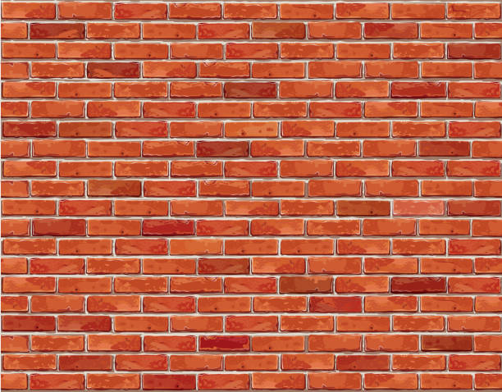
Stick Skills
Wall Ball, Wall Ball, Wall Ball!
Form
Pace
Reps

Slide 5
Baldwin Wallace Men’s Lacrosse Wall Ball Test
Baseline
You will start with multiple balls by your feet
You must stay minimum of 5 yards from the wall
You will be tested with gloves AND helmet
Test is done in order
Must be complete reps for them to count
Your goal is 5:15, poles and goalies under 5:45 minutes
Test is 220 Reps total
Test
25 RIGHT HAND one cradle and out
25 LEFT HAND one cradle and out
15 CROSS HAND RIGHT
15 CROSS HAND LEFT
25 QUICK STICK RIGHT
25 QUICK STICK LEFT
15 STRONG 1 HANDED cradle and out (Shovel passes for poles and goalies)
15 WEAK 1 HANDED cradle and out
30 SPLIT DODGES (Each throw/catch is 1 rep)
15 RIGHT HANDED Bounce back (Hit low brick on wall, catch off the ground)
15 LEFT HANDED Bounce Back

Slide 6
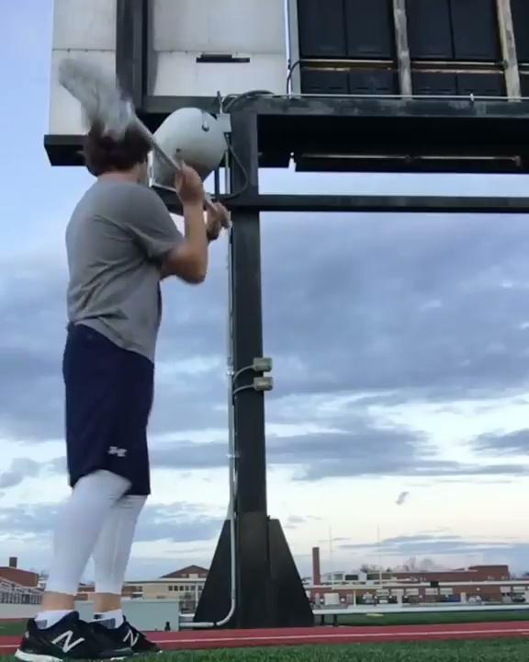
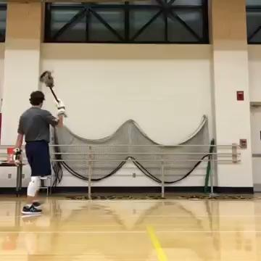
Improve Every Day
Challenge Them!!

Slide 7
Shooting
QUALITY REPS
Form – Stick Protection – Shot Placement
Over The Cage - Stationary
Spin & Fire - Stationary
Phone Booth - Stationary
Question Mark - Stationary
Up The Hashes – On The Run
Cone Work - On The Run
Layups - On The Run

Slide 8
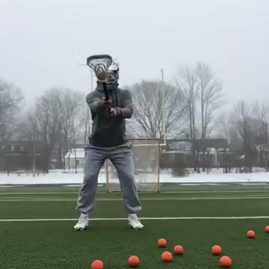
Spin & Fire
Start with your stick straight out and perpendicular to the goal
Whip your head around
Open your hips
Point your foot and shoulder towards your target
Snap your wrists

Slide 9
Spin & Fire
Working on form as well as accuracy
5 yards above the crease on a 45 degree angle
Outside hand
Sit low
Open hips
Transfer weight
Snap wrists

Slide 10
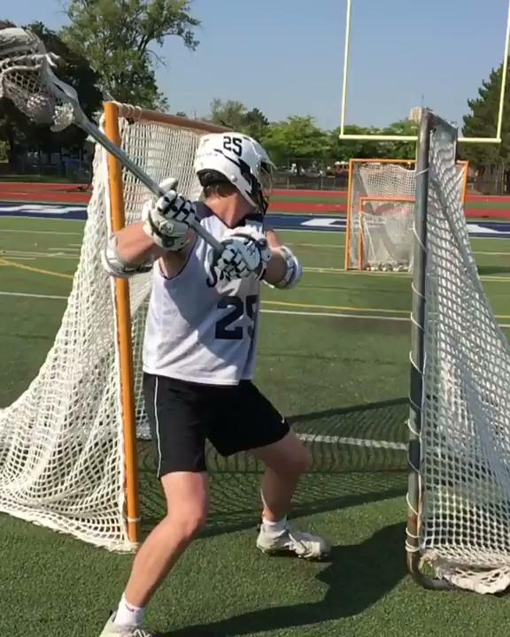
Phone Booth
Start with your stick straight out
Butt end aiming at your target
Point your foot and shoulder towards your target
1-2-3 SHOT
Snap your wrists

Slide 11
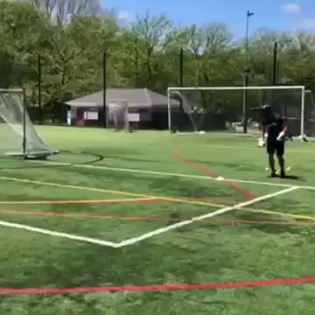
Up The Hashes
Start right behind GLE
Make a move while still protecting your stick
Finish UP FIELD
DO NOT FADE AWAY
Change up your shot placement
Shoot within 5 yards

Slide 12
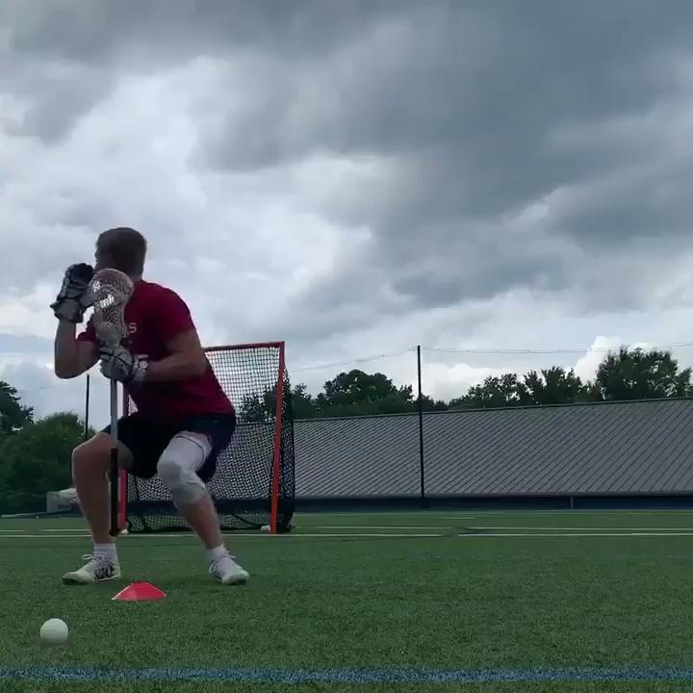
Question Mark
Start where you would turn on the island
Use your body to hide your stick
Punch hands to the outside away from your body
Turn so you are facing the goal and locking in on your target
Point your butt end
Snap with your wrists

Slide 13
Footwork & Dodging
Cone Work & Speed Ladder Are GREAT For Developing Fast Feet
Good Dodgers Know Where And How To Attack!
Pre Dodge Movement – Primary Dodge – Secondary Dodge

Slide 14
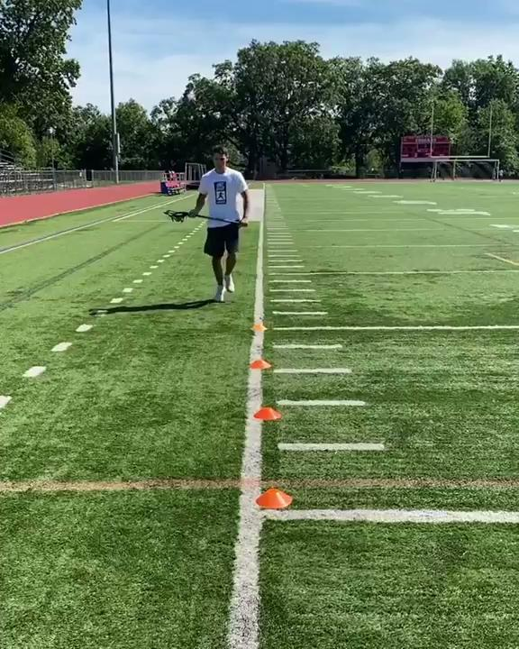
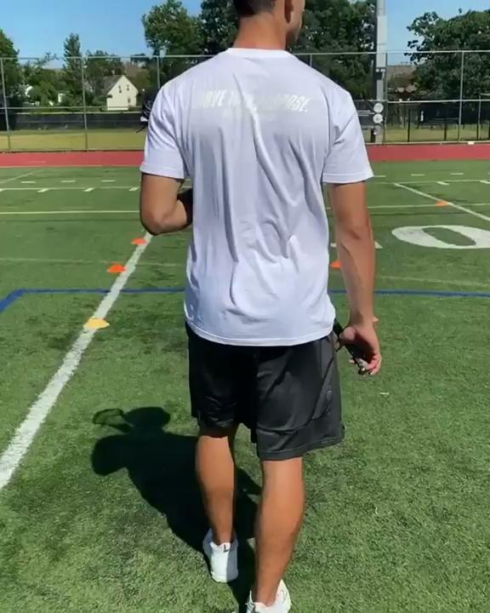

Slide 15
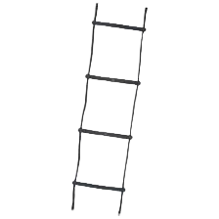
3 Cone Midfield Dodging
Go through the speed ladder and split to the inside.
2 Progressions
When you hit the second cone, roll to the outside and shoot on the run.
When you hit the second cone, bounce and pump, continue over the top for a shot on the run.

Slide 16
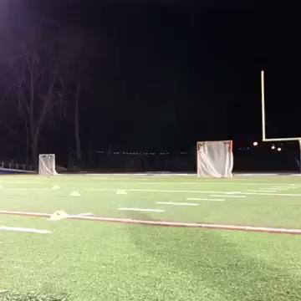

Slide 17
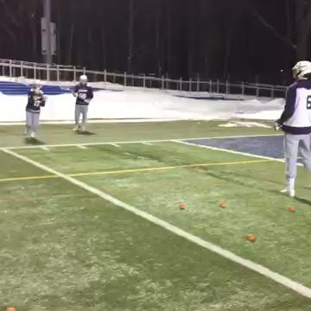
Light Post Passing
3 players
8-10 yards apart
Two outside and one inside
Inside player is constantly moving
He will receive a pass, pass back, then wrap around the outside line towards the far side player
Communicate!!!

Slide 18
4-Man 2 Ball
Outside players are on the box lines
Inside players are within the hashes
Balls start in the outside lines
The two inside players receive passes from the outside lines, pass back, turn around and go to the other side!
Continuous for 1 minute
Switch roles
Communicate!!!

Slide 19
Spoke Passing
Cones should be spread out within the box
Offense players are anticipating the ball movement and cutting upfield at the appropriate angle!
Giving their teammates a target, they receive the pass and either roll or split away from pressure
Progressions
Outside Hand Catch, Roll and, Pass (R/L)
Outside Hand Catch, Split and, Pass (R/L)
Inside Hand Catch and Pass (R/L)
Over The Shoulder Catch and Pass (R/L)

Slide 20
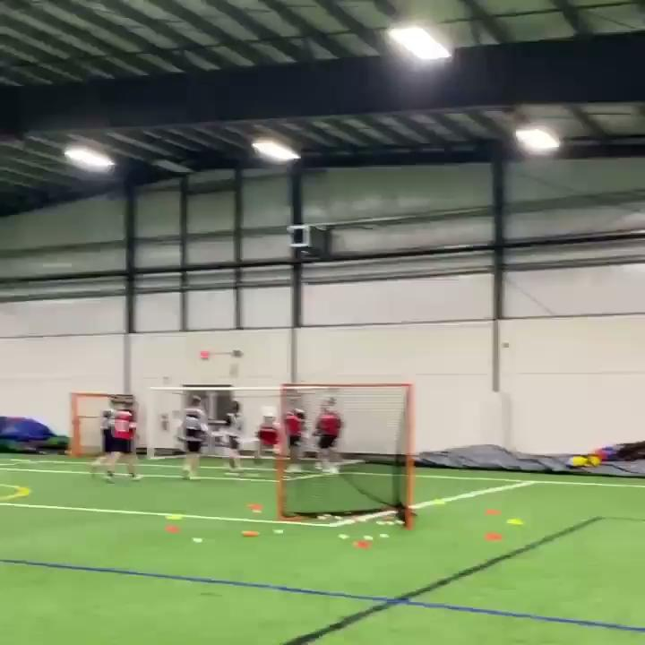
Zig Zag Drill
Start on one side of the cage
Split underneath
Bounce at X
Don’t be afraid to add a pump fake or a look back as you bounce!
Bounce at GLE to a shot!

Slide 21
7 Cone From X
Start at X
Drift to the first set of cones and split to the inside
Continue hard past the back of the cage
Change of direction at the second set of cones
Bounce and pump fake coming around the corner
Drive hard to the island
Over the top
Question Mark
Inside Roll

Slide 22
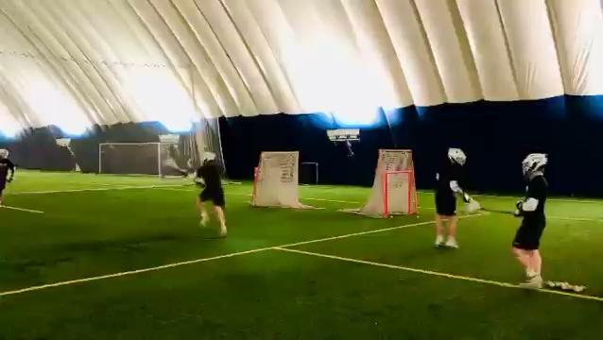
Back To Back Finishing
Continuous finishing/Up the hashes drill
Two cages and two lines
Catch ball on the move, protect your stick, finish up the hashes or inside roll!

Slide 23
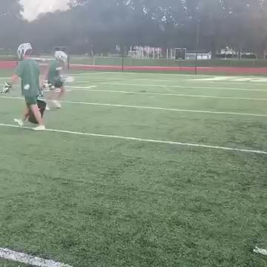
2 Cage Shooting
Dodge over the top for a shot on the run over the first cage
As soon as your first shot is taken, turn around, switch hands, receive another pass for a step-down shot!

Slide 24
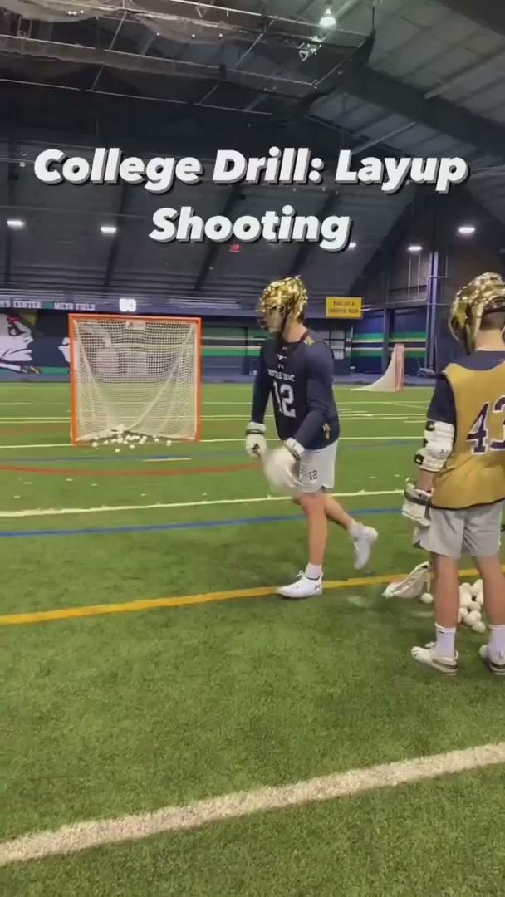
Lay Up Shooting
Start with your hips and shoulders square to the cage
Split and turn so your chin and shoulder are facing your target
Punch your arms up and out
Transfer weight! Close the gate (hips)
Drive off your inside foot

Slide 26
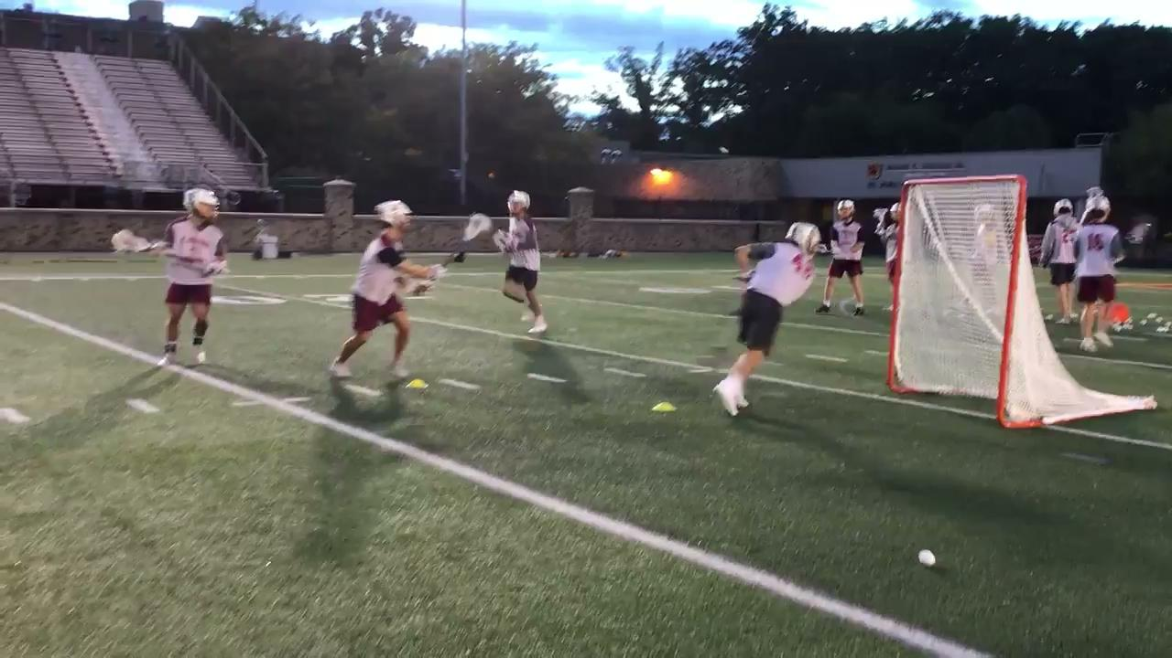

Slide 27
Just To Review!
Stick Skills
Wall Ball, Wall Ball, Wall Ball!
-Form
-Pace
-Reps
Light Post Passing
4 Man 2 Ball
Shooting
Spin & Fire
Over The Cage
Phone Booth
Up The Hashes
Question Mark
Zig Zag
Back To Back Finishing
2 Cage Shooting
Layup Shooting
Footwork & Dodging
1 Jab
2 Step Split
3 Step Split
Speed Ladder
Cone Work
3 Cone Midfield
7 Cone From X

Slide 28
Thank You For Coming!
Feel Free To Reach Out With Any Questions!
Mperrino@bw.edu
440-666-8112

