Slide 1
Man-up: Personnel – Formations – Plays
P.J. Kavanagh
Burning River / Hoover High School

Slide 2
Introduction
Current:
Burning River / Head Coach
Hoover High School / Offensive Coordinator
Coaching experience:
3 years of professional
MLL Ohio Machine, Bridgeport Barrage
17 years of college
Plattsburgh State (NY), Mount Union, Wooster
13 years of high school
Henninger HS (NY), Trinity-Pawling School (NY), Avon Old Farms School (CT), Hoover HS
12 years of youth lacrosse – New York, Connecticut, Ohio
Various youth programs and camps

Slide 3
Man-up
Huge opportunity to swing the momentum of the game!
Capitalize on other team’s mistake
Utilize your best players in an organized setting
SMART Goals:
Must establish standards for your team so they have measurable goals:
6v5: 40%
5v4: 50%
6v4: 60%

Slide 4
Personnel
Find the BEST FIT PLAYERS to give you a SETTLED SITUATION GOAL
Not necessarily the ‘best players’ on your team
Must be the smartest group of unselfish players with the best sticks
This may not include your stud dodging goal-scorer!
You must have the fortitude to sit certain players if they don’t fit the man-up mold!
You will be surprised (and probably already know) how keeping certain players off man-up can be a huge tool to reel in selfish players!
Many teams have a man-up specialist or two on the bench
Watch some college or good HS games and see who trots off the bench to play man-up
Could be a lefty, a great feeder, an excellent T/R shooter – someone who may not contribute in other ways
Maybe this won’t work with some youth teams…but you might be surprised

Slide 5
Personnel
Righties and Lefties
To the best of your ability, try to find a mix!
How many?
3 & 3 – if you are lucky enough to have an abundance of lefties, there are lots of options!
4 & 2 – lots of plays you will find are structured around this arrangement of R/L players
5 & 1 – maybe your team only has one lefty (or righty!) capable of playing man-up?
6 & 0 – you can find options to run with no lefties (or righties)
You are often better off putting your best 6 options on the field, regardless of what hand they are, if they are your smartest, team-oriented players

Slide 6
Formations
Lots of factors will dictate what determines your base formation
Your inherent bias towards a particular formation
Some folks LOVE 3-3 and others LOVE 1-3-2, etc.
More important to find what works for your team vs. what you like best
Number of lefties and righties
If you only have 1 lefty, maybe using a 3-3 isn’t for you?
Skill sets
You have limited (or zero) shooters who can really stretch the field?
You have an EXCELLENT feeder and a couple of good inside guys?

Slide 7
Formations
Best talk I ever heard was by Jeff Tambroni, Penn State Head Coach
Find your base formation that fits your personnel
Run your play immediately – don’t waste time passing ball around
Youth coaches know that doing that will likely lead to dropped passes anyway!
You will end up in base formation within first 15-20 seconds of the penalty
Have a restart play for when you back-up a shot (end in same base formation)
This was the best advice I ever heard about man-up and I have tried to employ with my teams since I heard it!

Slide 8
Formations
3-3 Base Formation
#1 Player must be at the point
This is where most decisions and plays are initiated
R1/L1 are at the low corners
These are your next two best players and must be able to feed and finish
CA is the crease option
Probably your 4th best player and must be active/adept at moving/finishing inside
R2/L2 are at the top corners
Yes, you want big shooters up here, but these are the #5 & #6 players of the unit

Slide 9
Formations
3-3 Base Formation
Looking to earn skip lane opportunities
Passing lanes to/from the point and the low corners are traditionally good looks
Feeding into the crease from the low corners or the point are also good looks
If your crease player is very good, he may also find ways to pass the ball back out to the high corners for steps downs
Encourage players to work on an arc so that the defense rotates out to moving perimeter personnel – curl back to the ball
Moving the ball around the perimeter is what will eventually open up these skips lanes
Can practice this by not allowing skip passes for a period of time in practice (5-10 minutes), and then introducing them later
Use this as a progression in your practice!

Slide 10
Formations
3-3 Pull to Right
3-3 Pull to Left

Slide 11
Formations
1-3-2 Base Formation
#1 Player must be at the X
This is where most decisions and plays are initiated
R1/L1 are at the wing shooting corners
These are your next two best players and must be able to feed, finish and shoot from 10x10
CA is the crease option
Probably your 4th best player and must be active/adept at moving/finishing inside
R2/L2 are at the top corners
Again, big shooters up here, but these are the #5 & #6 players of the unit

Slide 12
Formations
1-3-2 Base Formation
Looking to earn skip lane opportunities OR a late rotation for a time/room shot
Passing lanes to/from X to the top shooters are good looks
Feeding into the crease from the low corners or X can work if the defense is filling backside slowly
Wing shooters must curl back to ball as it moves over the top OR pinch the pipes as it moves away from them
Encourage players to work on an arc so that the defense rotates out to moving perimeter personnel – curl back to the ball
Again, practice great ball movement by forbidding skip passes for a period of time before opening skips lanes

Slide 13
Formations
1-3-2 Push Pipe Righty/Lefty
1-3-2 Wheel Off Push

Slide 14
Formations
1-4-1 Base Formation
#1 player preferably at the X
This is where most decisions and plays are initiated and he can push corners and sneak
R1/L1 are at the wing shooting corners
I prefer to put my next best players at these corners
Others may put 2nd best player at the point where i show R2
Both are good options – up to you and your personnel to determine what is best
CA & L2 begin in the crease
L2 could also be your 6th best player and another righty if you only have 1 lefty
Not a bad place to hide your weakest man-up guy
R2 is at the point
Remember, your R2 is supposed to be a good shooter and potentially one of your top 4 men

Slide 15
Formations
1-4-1 Base Formation
Looking to push corners from X
If the first shot is not available to either R1 or L1, wheeling the ball over the top can earn a step down for the opposite wing
Wing shooters must curl back to ball as it moves over the top OR find passing lanes when ball on opposite wing
Encourage players to work on an arc so that the defense rotates out to moving perimeter personnel – curl back to the ball
Can add stepping a player off the crease behind the ball (next slide)

Slide 16
Formations
1-4-1 Step off to X
1-4-1 Step off to point

Slide 17
Plays
The play(s) you choose must be based on several factors
What skill sets do my players possess?
Do I have an abundance (over-abundance) of righties or lefties?
Do I have great feeders?
Do I have any great outside shooters? How many? What hand are they?
What is my base formation?
Remember, we choose our base formation based on our players’ abilities, so whatever play we choose to run needs to end up in this base formation!
Who are my best players, and how do I want to get them the ball?
If your best player has some range with his shooting, the 3-3 can be a good choice, if he is a better feeder than a shooter, then maybe you should be in a 1-3-2…
Who are we playing – what do they do best?

Slide 18
Plays
Get into your play! Moving the ball on the perimeter is a good way to waste man-up time…
Think about it – you have a :30 penalty and if you spend 10-15 seconds of that penalty time moving the ball on the perimeter, you may only have one shot at your play developing into a shot opportunity!
Give yourself multiple chances to score by getting into your play quickly:
This gives your play a chance to work to earn a shot
Your base formation has a chance to exploit your man-up opportunities
You now have a chance to run a secondary play / restart after a shot

Slide 19
Plays
3-3 to 1-3-2 to 3-3
NEED: 4 solid players, 3 Righties, 1 Lefty
R1 & R2 can switch if R2 is unable to make decisions with the ball and R1 can shoot
L2 and CA are least important (can hide)
This play is good if your best player has some range and makes excellent decisions and your base formation is a 3-3
Must have a good righty time/room shooter AND a good righty finisher to sit on the pipe
Important to have one lefty who can shoot from range
Least important players for this play are your crease attackman and your second lefty player
You start and end in a 3-3

Slide 20
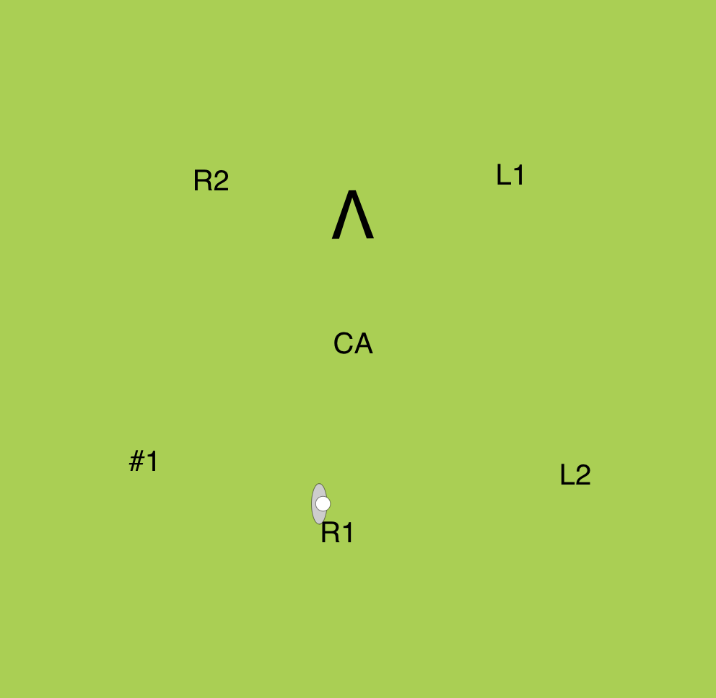
Plays
Step 1: 3-3 to 1-3-2 to 3-3
Step 2: 3-3 to 1-3-2 to 3-3

Slide 21
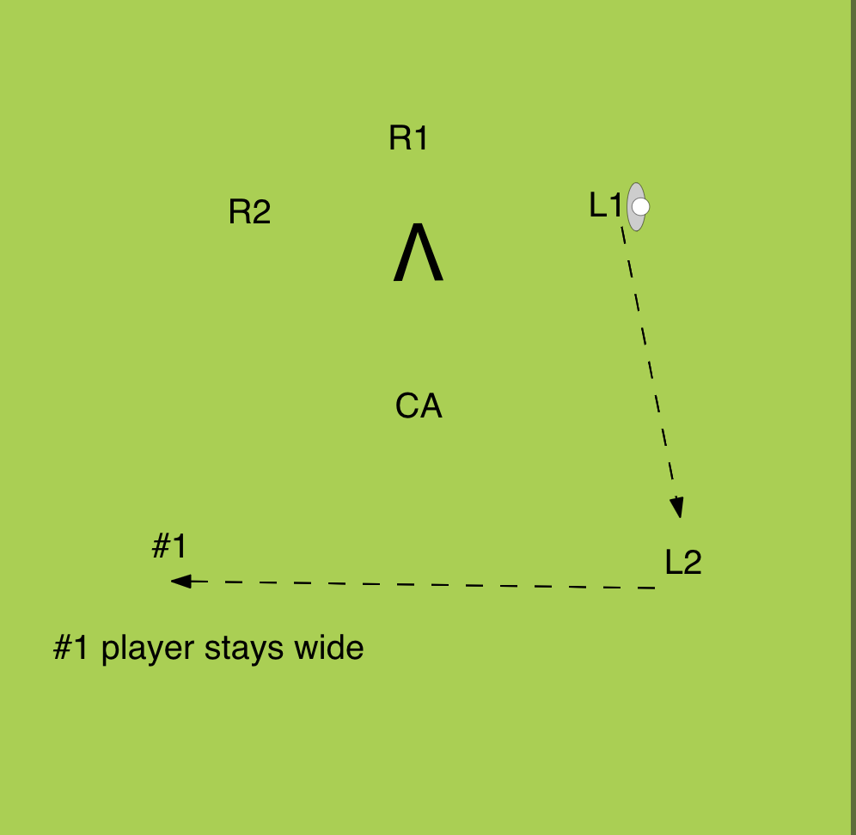
Plays
Step 3: 3-3 to 1-3-2 to 3-3
Step 4: 3-3 to 1-3-2 to 3-3

Slide 22
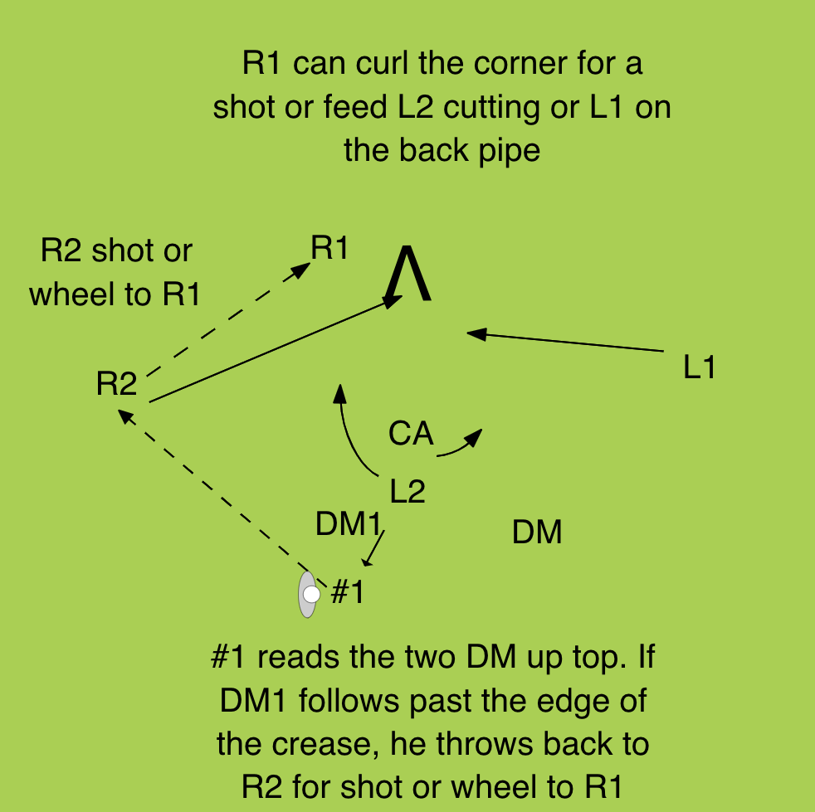
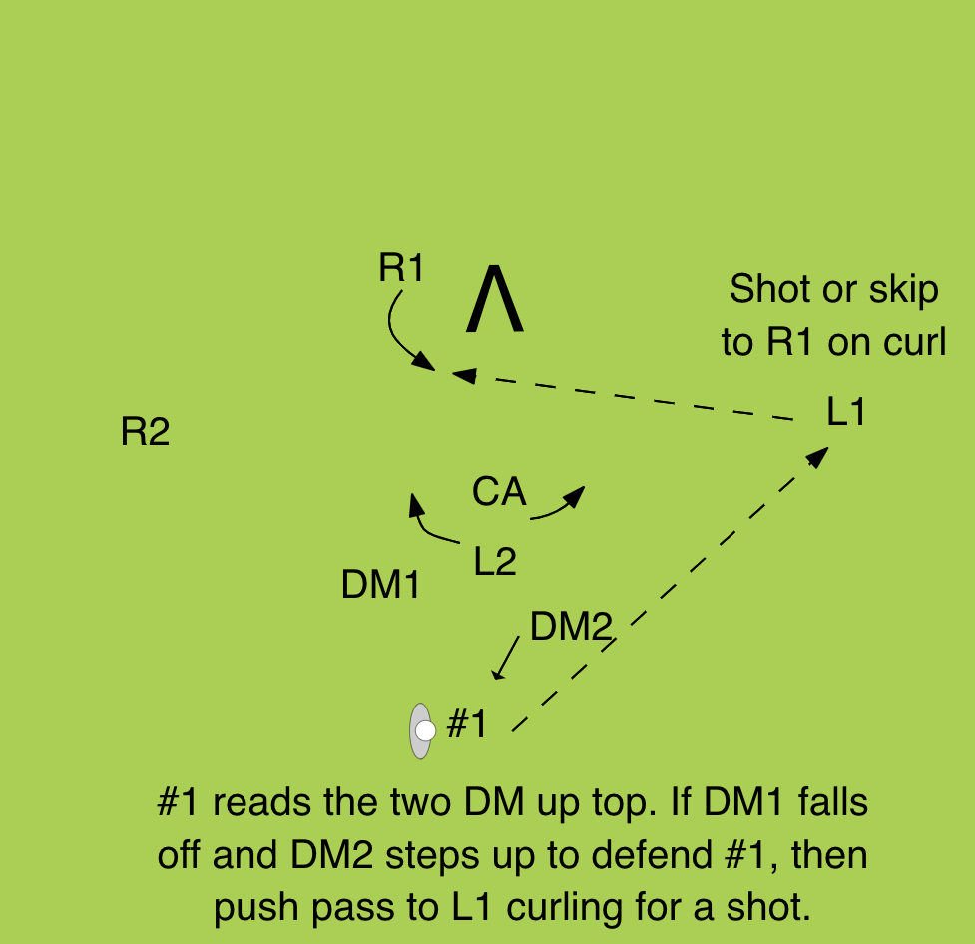
Plays
Step 5: 3-3 to 1-3-2 to 3-3
Step 6: 3-3 to 1-3-2 to 3-3

Slide 23
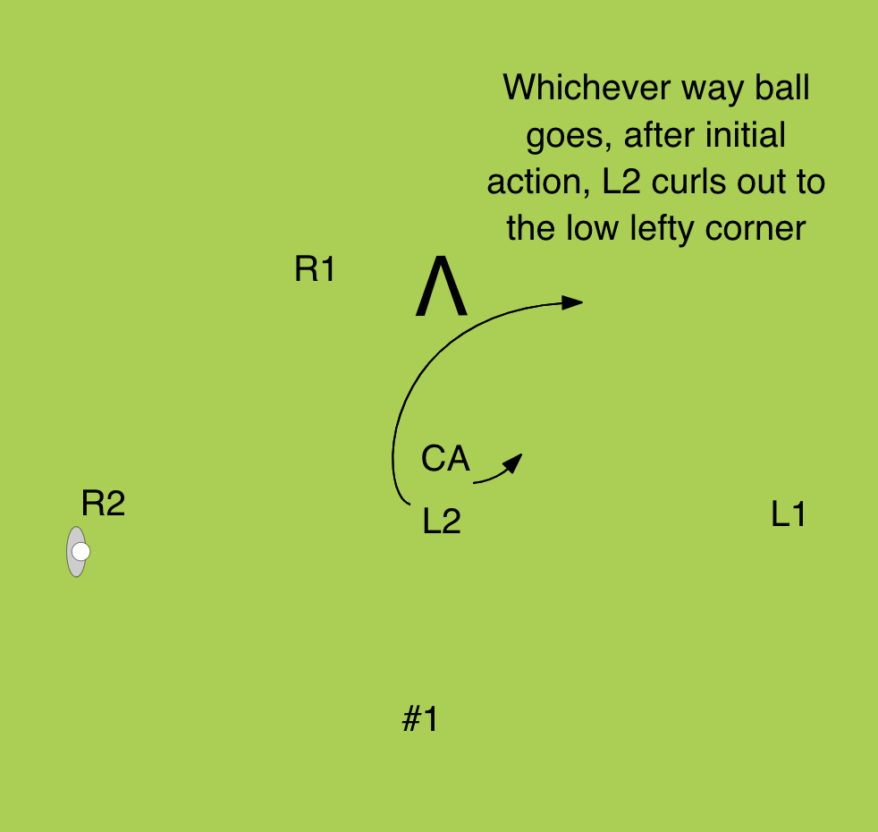
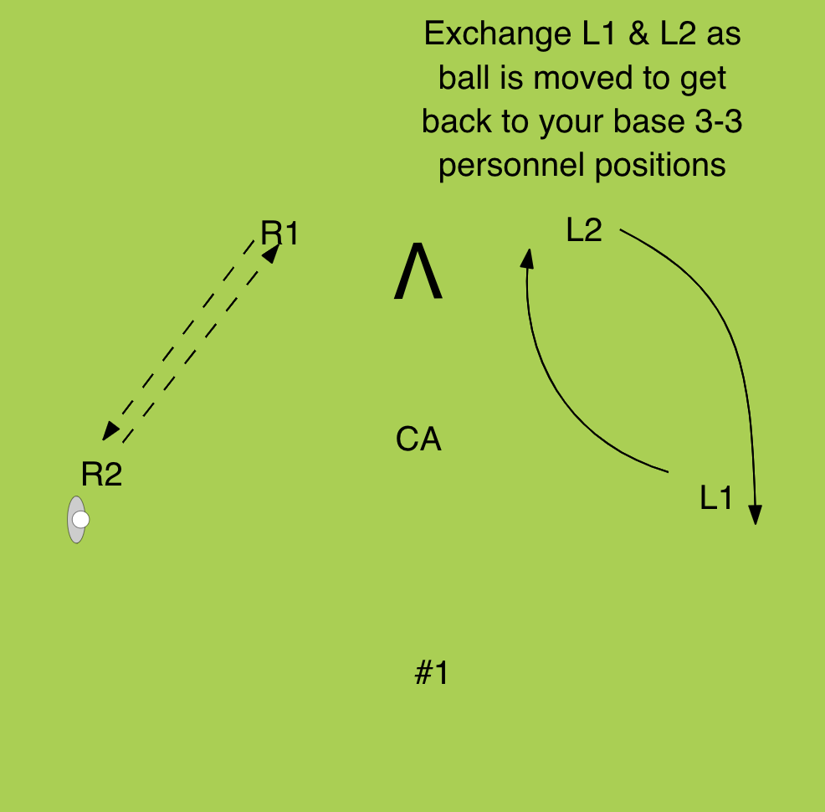
Plays
Step 7: 3-3 to 1-3-2 to 3-3
Step 8: 3-3 to 1-3-2 to 3-3

Slide 24
Plays
1-4-1 to 2-1-3 to 1-4-1
NEED: 4 solid players, 3 Righties, 1 Lefty
Can also run this with 6 righties!
R3 and CA are least important (can hide)
This play is good if you have 5 righties (or even 6 righties) and your crease guy is crafty
Must have a good righty time/room shooter at R2 AND your #1 player must be able to shoot from at least 8-10 yards
If you have one lefty, he must be smart and able to feed
Places to hide players are at R3 and CA
You start in a 1-4-1 and end in any formation you want. I show ending back in a 1-4-1

Slide 25
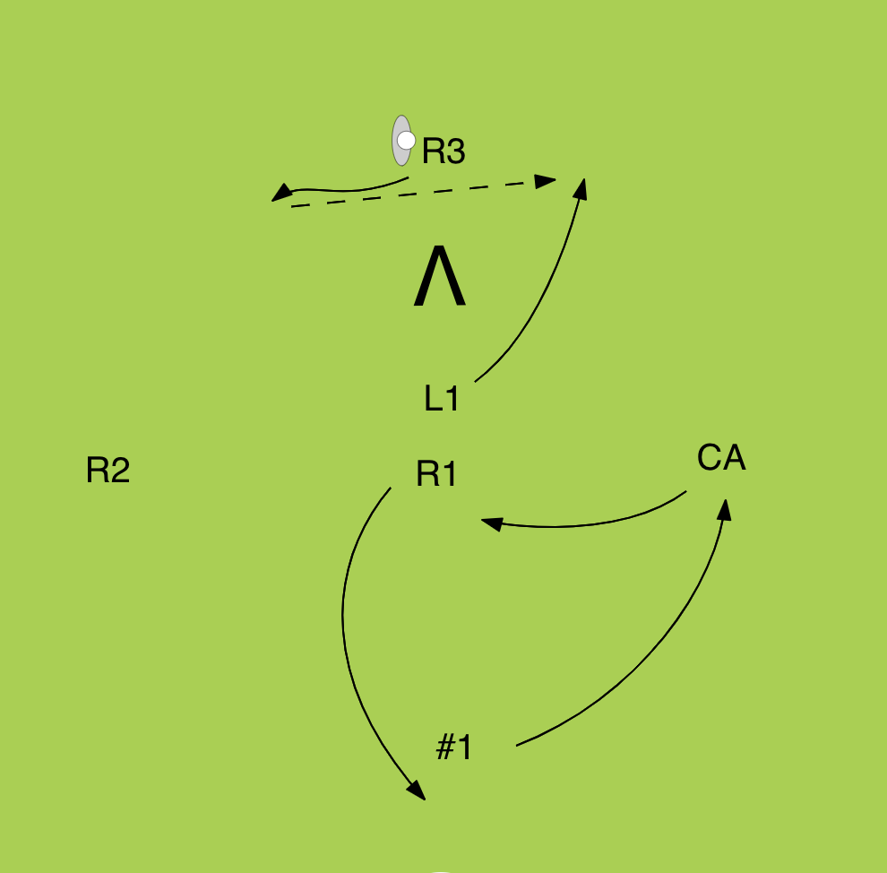
Plays
Step 1: 1-4-1 to 2-1-3
Step 2: 2-1-3 looks

Slide 26
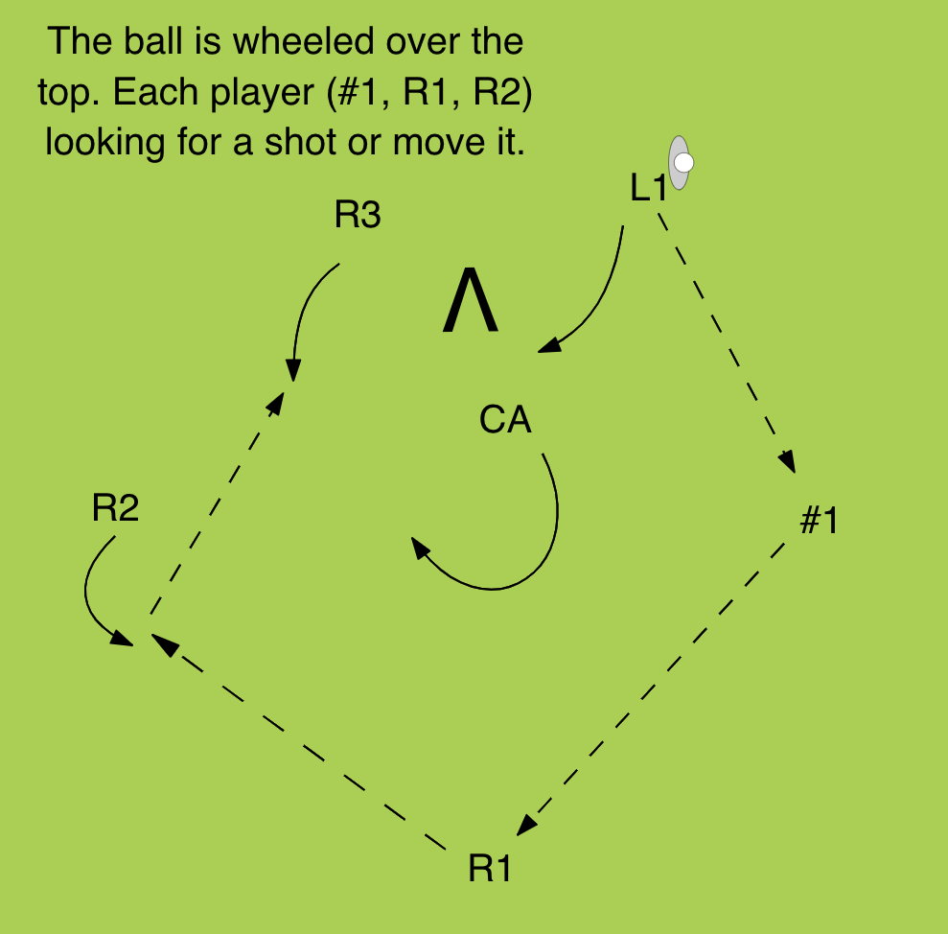
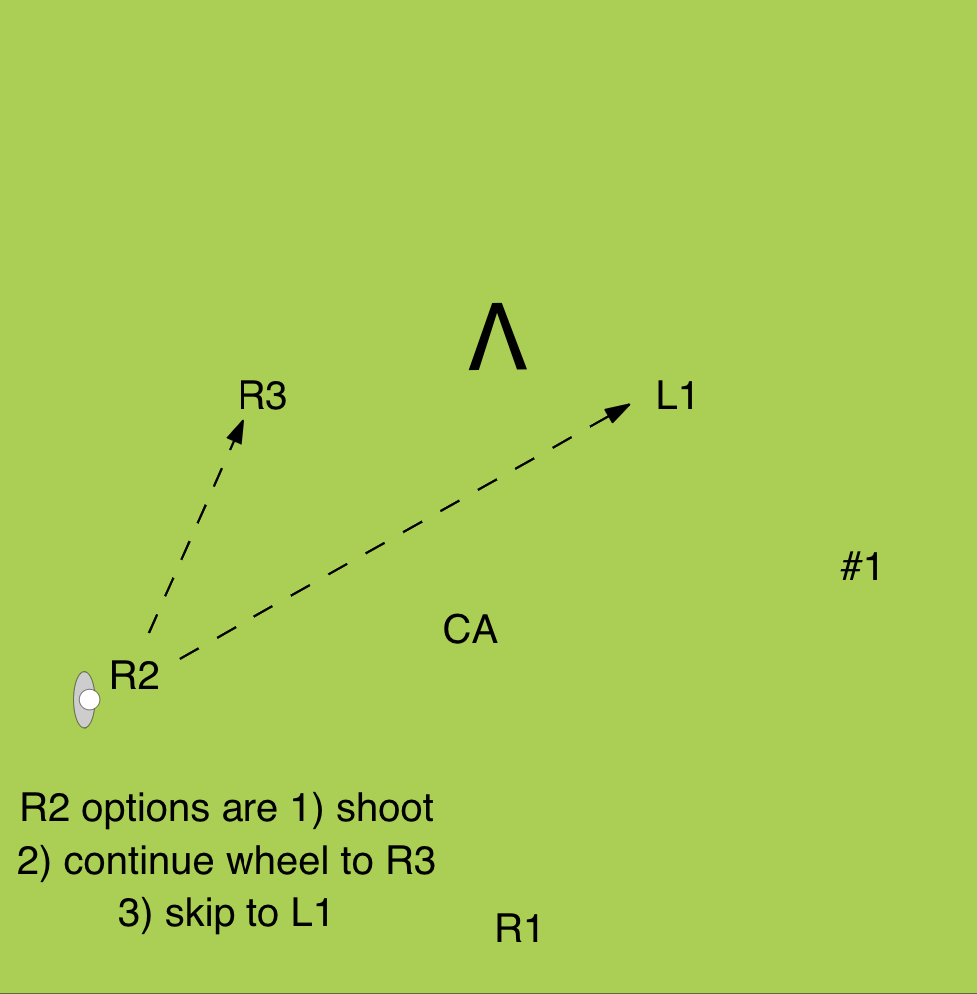
Plays
Step 1: 2-1-3 wheel
Step 2: 2-1-3 options

Slide 27
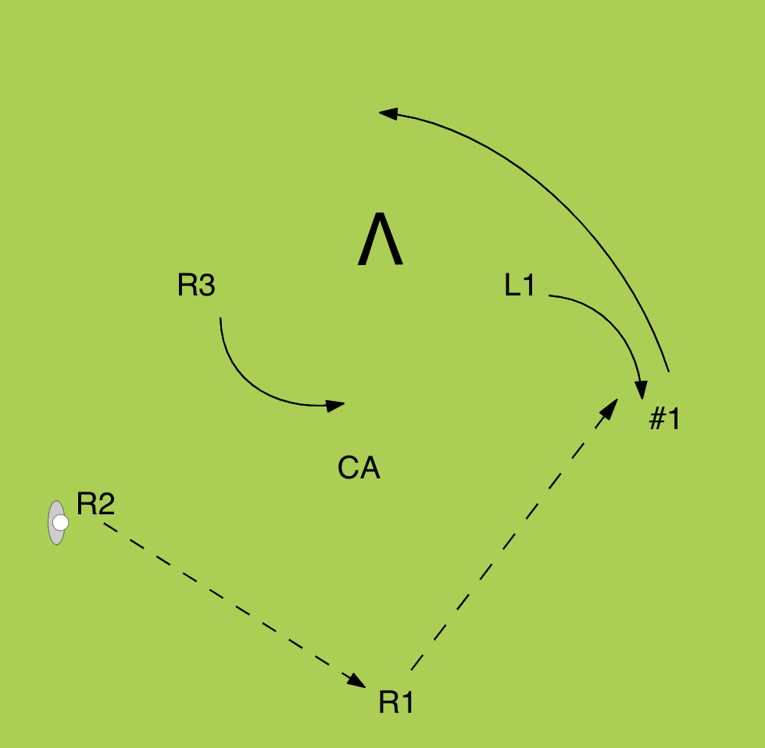
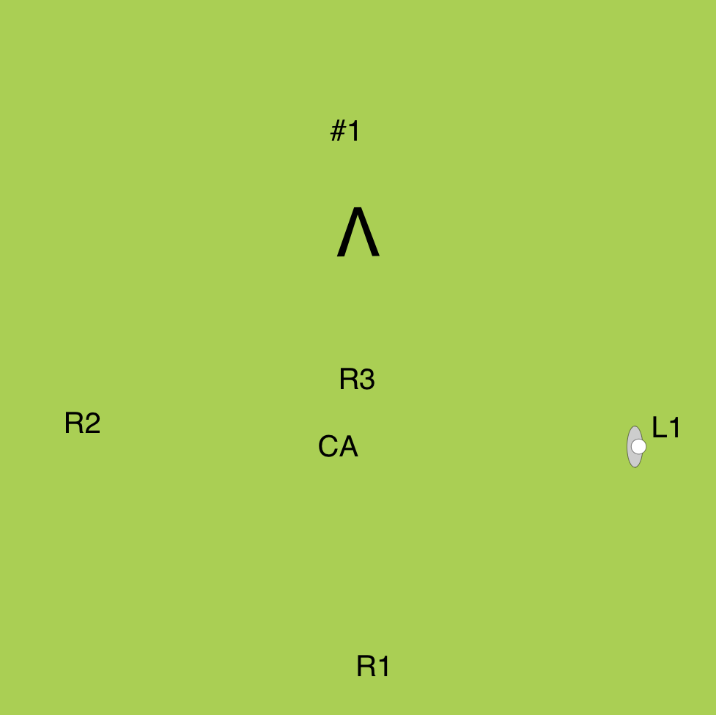
Plays
Step 1: 2-1-3 to 1-4-1
Step 2: 1-4-1 base formation

Slide 28
Conclusion
A good friend and mentor of mine, Coach Ted Garber, once told the team he has ‘more plays that Shakespeare.’ I always thought that was fantastic. You can have that many plays, too!
Be creative!
Do an honest evaluation of your best personnel for settled situations and give them a chance.
Keep things as simple as possible.
Always thinking – personnel, formation, plays.
Good luck this spring.

