Slide 1
Burning River Lacrosse
Goalie Fundamentals and Training
Points of Emphasis
All Shooters Are Stupid – 85% of goaltending is body position
Mental aspect:
PMA – Positive Mental Attitude
Quarterback of the defense
Your real job is to make up for the mistakes of the people in front of you, because if they never made a mistake, you’d never see the ball.
Physical aspect:
Should be one of top athletes on team
Efficiency of movement (straight line aspect)
Put pressure on the shooter (Correct positioning results in 90% of saves)

Slide 2
Burning River Lacrosse
Goalie Fundamentals and Training
The ready position (How do I stand?)
Stick position (How do I hold the stick?)
The Arc (Where should I be in the cage?)

Slide 3
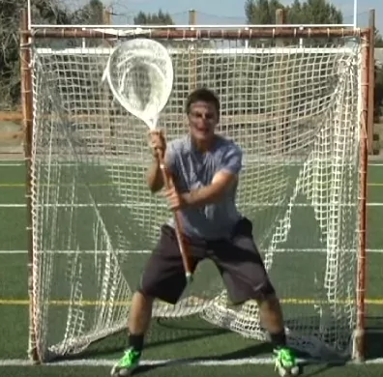
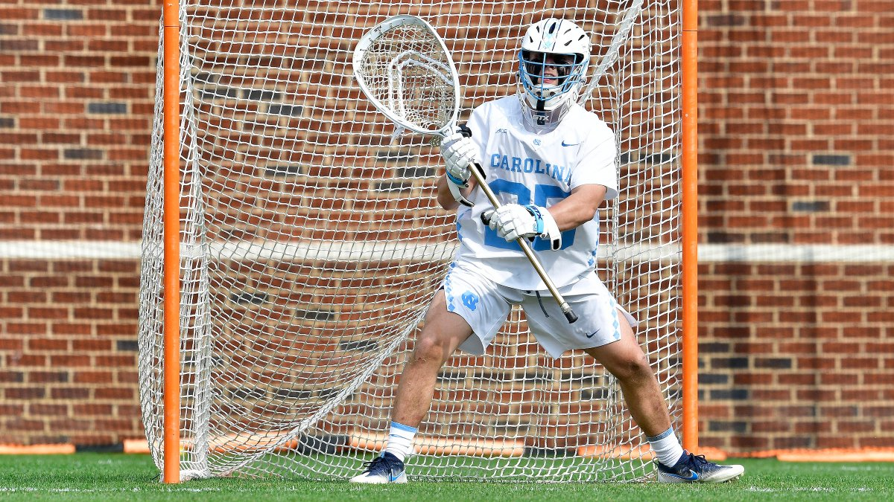
Burning River Lacrosse
Goalie Fundamentals and Training
Focus on Fundamentals

Slide 4
Burning River Lacrosse
Goalie Fundamentals and Training
The shot (How do I stop the ball?)
Off stick shots
Bounce Shots
Tight Shots (What top goalies save)

Slide 5
Burning River Lacrosse
Goalie Fundamentals and Training
Sweeps on top
Sweeps around cage
Ball Behind Cage

Slide 6
Burning River Lacrosse
Goalie Fundamentals and Training
The throw
Talk
Clears
Attitude

Slide 7
Burning River Lacrosse
Goalie Fundamentals and Training
Goalie Warm Up Procedures
Remember that the warm-up is for the goalie, not the shooter.
Help the goalie gain confidence by shooting to certain spots on the cage, not to score.
Every third shot in warm-ups should lead to a breakout pass.
Every tenth shot should be wide and force the goalie to turn and chase to the endline.
The sequence of shots is as follows: Remind them to step!!
5 shots stick side high
5 shots off stick side high
5 shots stick side hip
5 shots off stick side hip
5 shots stick side bounce
5 shots off stick side bounce
5 shots between the legs
15 shots anywhere
While shooting on the goalie. Remember to keep moving and walk around an arc 10 to 15 yards away from the cage. Shoot the ball ½ to 3/4 speed until you start to mix them up. You are there to warm the goalie up not score on him. Be aware of the skill of the goalie when choosing the speed of the shots.
Please stick to the above warm up to insure that all goalies get 50 quality shots.
Ideally, warm up should take no more than 10 minutes per goalie.
Do not rush, allow goalie time to get into proper position.
Constantly monitor the goaltender for proper positioning. If they are out of position correct their position immediately. Flaws should be corrected quickly so that they do not become bad habits.
Any goalie not being warmed up should be behind the goal backing up the net.

Slide 8
Burning River Lacrosse
Goalie Fundamentals and Training
Drills
High saves with just a shaft (use tennis balls)
Butt End with tennis balls
D – Stick
Use defense stick to make off stick bounce shot save
Turns from X
Focus on creating a pivot foot and rotating on it to be in good goalie position
Turns from X - ND Irish Guard Drill
Coach comes from X and looks to tuck it short side –
Hold pipe, match sticks, step to close cage off.
Make them shoot for the back pipe

Slide 9
Burning River Lacrosse
Goalie Fundamentals and Training
Drills
Protect the can (use tennis balls)
Put a garbage can to the side of the goalie
Use an empty stick (no net) or shaft
Shot bounce shots at the can. Goalie has to move body to make a body save.
2 cages
put two cages side by side, goalie in middle, shot to pipes to force to explode to ball
Put two cones at 30 degree to force them to step out.
Sledge Hammer with tennis balls
Make saves with a sledge hammer instead of a stick to improve wrist strength and reaction time

Slide 10
Burning River Lacrosse
Goalie Fundamentals and Training
Drills
Knee bounce shots
Focus on keeping hands in front, On knees with just a shaft
Step in front of drill (use other goalie or garbage can)
Churn the butter
Off stick to outlet (Snap the outlet)
Long Passes
Over 1 cage in to another.
Set cages 6 feet apart
Tennis balls and racquet rapid fire shots
Ladder to a shot
Use a 4- step pattern to get to end of the ladder
Once the player finishes the pattern coach takes shot
Balls in the bucket Drill

Slide 11
Burning River Lacrosse
Goalie Fundamentals and Training

