Slide 1
HOW TO BEST CONDITION YOUR ATHLETES FOR SUCCESS
BY LAWRENCE WYNN JR

Slide 2
Brief background
BS in Exercise Science, University of Akron
National Strength Coaches Association – CSCS (Certified Strength & Conditioning Specialist)
Assistant Strength & Conditioning Coach, Archbishop Hoban, 2015-2021
Director of Strength & Conditioning, Gilmour Academy, 2021-Present
Combined 8 years of strength coach experience training middle school, high school, and personal training collegiate & professional athletes

Slide 3
DYNAMIC > STATIC WARM UP
If you are not implementing a dynamic warm up with your athletes prior to practice or running you are doing them a disservice.
A 5-10 minute dynamic warm up will help prepare your athlete’s bodies for the intensity of whatever activity they are going to do that day.
A lot of coaches that have an old school approach and static stretch before high intense activity. Every coach has their preferences but I believe it is best reserved for after practice to increase flexibility and jump start the recovery process.

Slide 4
DYNAMIC WARM-UP
Slow Pace Warm Up Exercises
Lunges
Straight Leg Kicks
RDL Walk
Knee Tuck
Quad Pull
Crossover Groin Stretch
Fast Pace Warm Up Exercises
High knees
Butt kicks
Side shuffle
Carioca
Back Pedal
Short Burst

Slide 5
TRAINING GOALS
Ask yourself these questions:
What is your goal with conditioning?
Is this making my team better?
Coaches should avoid using conditioning as a punishment or a way to teach mental toughness
This is the quickest route to injuring athletes or creating a negative environment that your team won’t want to be apart of.
Everything you do as a coach should have a purpose and a goal attached to it.

Slide 6
CARDIO VS. CONDITIONING
CARDIO
10+ min bouts
Low intensity (Zone 2-3)
Continuous & Steady State
Builds cardiovascular base
CONDITIONING
<10 min bouts
High Intensity (Zone 3-5)
Interval (work/rest periods)
Builds VO2 Max
15-30 mins/week

Slide 7
TRAINING ZONES
ZONE 1 (50-60% MAX HR) Casual walking pace. Not a lot of aerobic adaptations but good for hitting daily activity goals.
ZONE 2 (60-70% MAX HR) is a good general aerobic training target zone for long runs.
ZONE 3 (70-80% MAX HR) Lactate threshold for the average person. Well trained athletes can reach closer to 85%. A good moderate intensity for mid-distance runs.
ZONE 4 (80-90% MAX HR) Fairly anaerobic. Great for longer intervals. Ex. 3 min hard run followed by 3 min walk
ZONE 5 (90-100%) this is very high intensity. Great for shot duration HITT training. Ex. 25 second sprint followed by 1:35 rest.

Slide 8
WORK TO REST INTERVALS FOR CONDITIONING
WORK INTERVAL | ENERGY SYSTEM USED | WORK/REST RATIO
5-10 SECONDS | PHOSPHAGEN SYSTEM | 1:12 – 1:20
15-30 SECONDS | FAST GLYCOLYSIS | 1:3 – 1:5
1-3 MINUTES | FAST GLYCOLYSIS / OXIDATIVE | 1:3 – 1:4
> 3 MINUTES | OXIDATIVE | 1:1 – 1:3
Speed Training: target about 1 min of rest per 10 meters of top speed work
Conditioning: work to rest ratio of 1:12-1:20. 10 seconds of work with 2-3:20 of rest

Slide 9
TESTING TO TRACK PROGRESS
FLYING 30’s – good test for straight ahead speed and acceleration
PRO AGILITY – good test for change of direction
300 YD SHUTTLE – good test for endurance and change of pace speed
It is a good idea to test regularly (4-6 weeks) in order to track progress of your athletes and help motivate them through competition, desire to improve their own numbers, and adherence to the validity of your program.

Slide 10
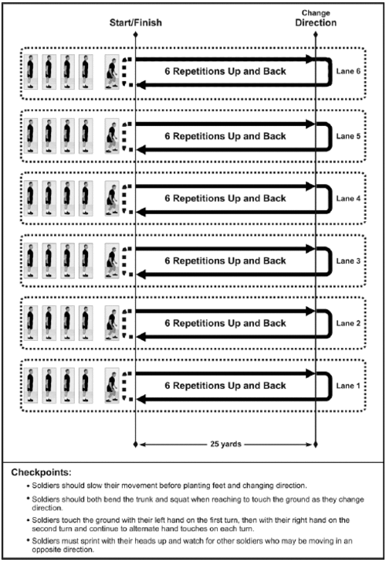

Slide 11
STEPS TO CREATING A CONDITIONING PROGRAM
1. EXERCISE MODE
2. FREQUENCY
3. INTENSITY
4. DURATION
5. PROGRESSION

Slide 12
EXERCISE MODE
Recommended mode of choice is running
Lacrosse athletes run on foot and should be training as such
Running on a playing field will be the closest way to mimic competitive game-like situations
Other modes of choice are recommended for athletes who are injured or are unable to participate

Slide 13
FREQUENCY
Speed and/or agility training 2x/week is more than sufficient to see consistent progress
Conditioning 2-3x/week to build VO2 Max and best prepare your team to last an entire game.
Cardio should be done 3-5x/week to maintain or increase a cardiovascular base. (Practicing at a continuous pace does count as cardio)

Slide 14
INTENSITY
Try to hit all intensities throughout the week. Low for cardio, moderate for conditioning, high for sprint and agility work.
Low Intensity = less than 70% MHR
Moderate Intensity = 70-80% MHR
High Intensity = More than 80% MHR

Slide 15
DURATION
Cardio = 20-30 minutes of continuous (at least 10 mins at a time) movement
Conditioning = 5-10 mins/session
Speed = 15-45 min/session
*Dynamic warm up does not count towards timed session

Slide 16
PROGRESSION
Increase total volume slowly over time.
Ex.
Monday – Pro Agility x4 (80)
Tuesday – Gassers 30 yards x4 (120)
Wednesday – Rest
Thursday – Hill Sprints 20 yards x 3 (60)
Friday – 300 yard shuttle (300)
560 yards of total volume for the week. Next weeks volume should not go above 616 yards of total volume.
Add volume to where you believe your team is lacking.
Don’t increase total volume by more than 10% each week to avoid injury or overtraining

Slide 17
Personal preferences
Speed & agility training 2x/week before practice (after dynamic warm up, while fresh and able to give max effort)
Conditioning 2x/week at the end of practice (do not need to warm up again if done at the end of practice)
Implement at least two 10 min bouts of cardio during each practice (scrimmages or continuous skill sessions)
Focus volume on weaknesses of the team

Slide 18
Q&A
Comments or Questions?
Email: wynnl@gilmour.org

