Slide 1
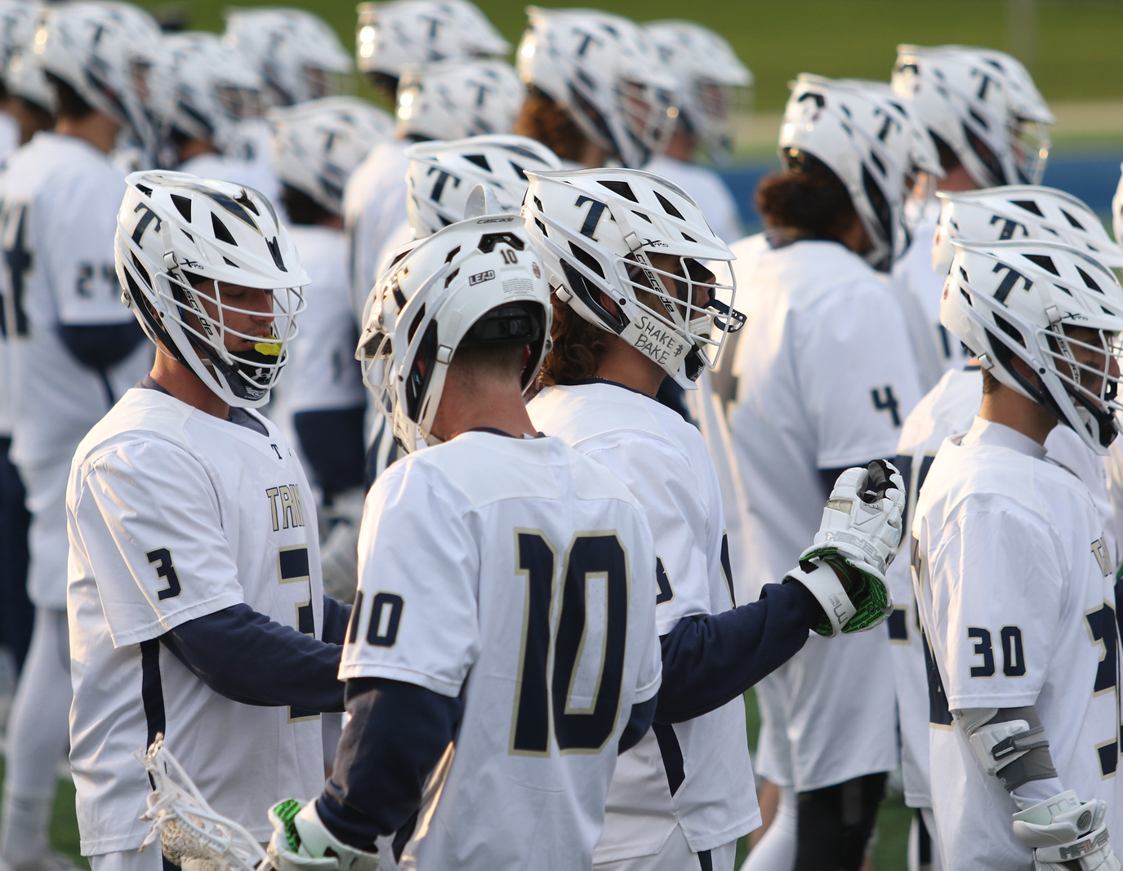
TRINE UNIVERSITY DEFENSE
Ryan Kuhn
kuhnr@trine.edu
Office –
260-665-4462
Cell –
631-796-4694

Slide 2
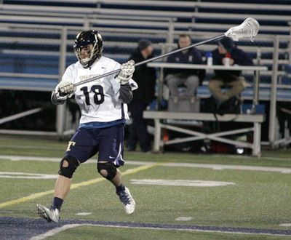
What We Want - Individually
Defensive Stance
Sit back in a chair
Athletic stance
Butt low
Knees bent
Feet are shoulder width apart
Head Up & Communicate
Head on a swivel/ Be Active Off Ball!
Tell your teammate when or if he will dodge
Teammates will tell you where/when the slide is coming
Use peripheral vision to situate yourself on the field and see picks.
COMMUNICATION IS THE LIFEBLOOD OF A GOOD DEFENSE!
90 Percent of Game is Off Ball
Drill Development –
Warm Up
Rondo/Wheel – 4 Cone Drills
Hand away from body
Use as a cushion to absorb the dodge
And push dodger back
Stick at 45 degree – We Approach with our Stick Out – Hand on the Gun In Our Holster
Ready for :
Check
Poke
Slap
Lift
BE CONFRONTATIONAL!
Play With Controlled Aggression
Be Disciplined!
Surgeons, Not Butchers

Slide 3
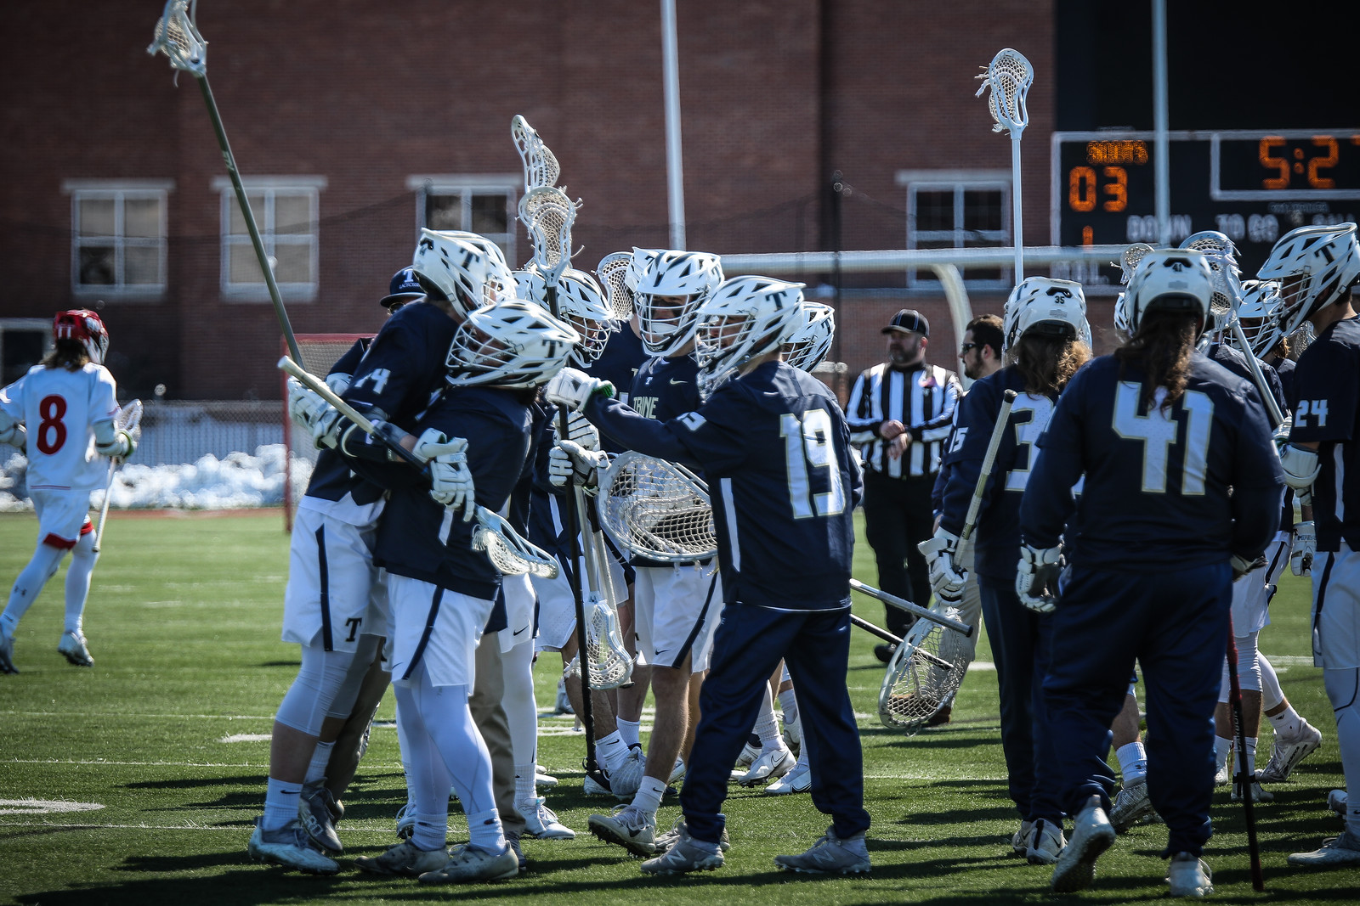
Some Reasons Why We Run Our Stuff!
We force teams to adjust to what we are doing. – SYSTEM OVER MATCHUP
We make offensive teams be patient for quality shots. Force great passing, and over passing! Our % goes up with number of passes we force
Limit opposing team’s offense, and the number of movements they will run.
We always have a defender in an immediate help position.
We can take away any individual dodgers that can break us down and force our defense to slide early.
We force teams to take shots outside 13 yards or feed the crease. we can dictate where shots will come from.
We force teams to throw through the defense which will allow us to pick passes off.
It allows us to breakout, and get up field with good balance.
We can play the ball very hard when it is up top and behind.

Slide 4
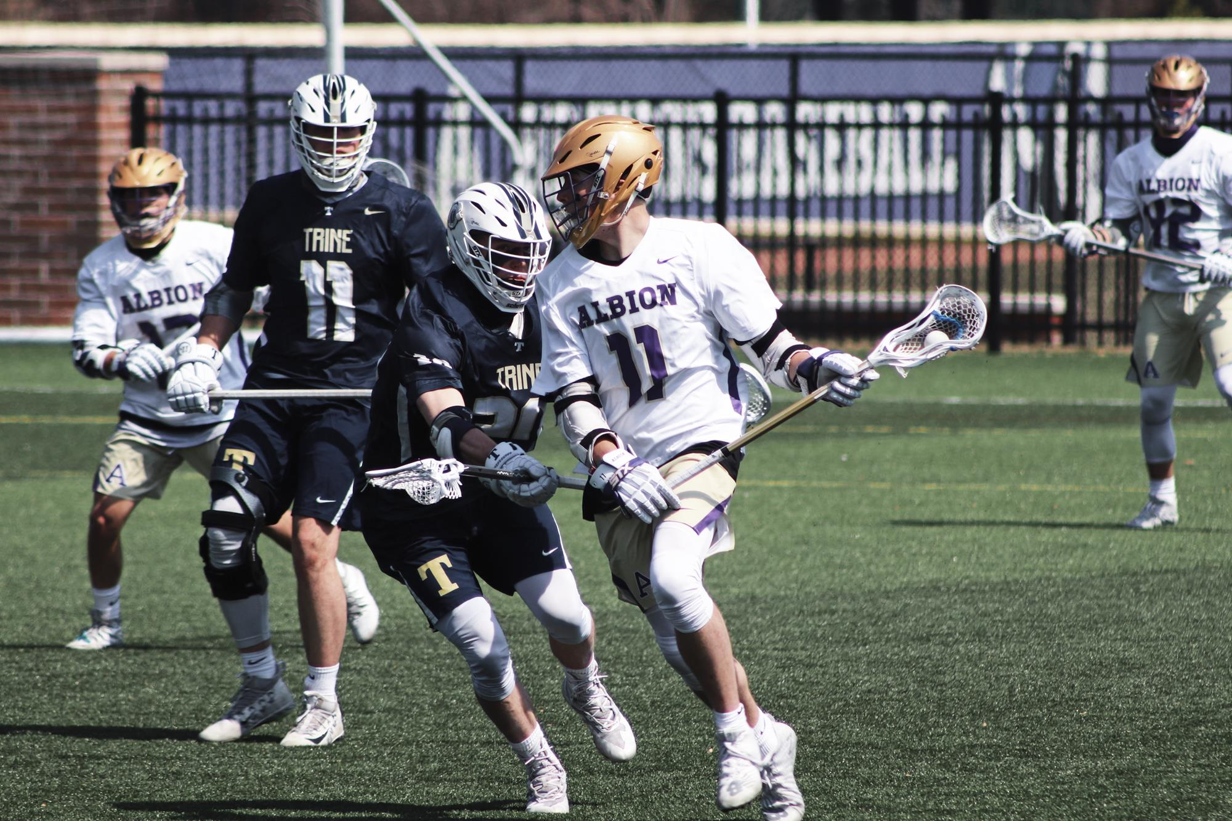
General Rules
COMMUNICATE – Goalie calls ball position and on ball instructions. Furthest man away from the ball sees the whole field and needs to lead communication and fill gaps.
THIS IS A HYBRID MAN – WITH ZONE HELP – WE WANT TO BE AGGRESSIVE ON BALL!!!!
We try and keep concepts simple, and let our defense anticipate, react, and play off of the offense’s reads.
How many players behind or up top sets our defense
“NEXT MAN UP” - Be confident and have a good approach to the ball because there is always help!
If the ball carrier is carrying away from you and you are off ball, always be in a help position.
If the ball carrier is carrying towards you and you are off-ball then get out to extend on the next pass.
Know that other players are getting in a help position smoothly at the same time.
Sticks up off ball in the passing lanes at all times!
GET ON BALL CARRIER’S HANDS
Get your hips to a corner off ball and see the ball, the crease, and your zone
All groundballs and loose balls in the crease area have to be ours. We have to have the mentality that every ball will be ours. Because we play zone, possessions are crucial for us. We can pressure loose balls 1v1 as we have help behind us.
No matter where the ball is, there is always adjacent help for the on ball defender. All five off-ball players are moving as a single unit behind the on-ball defender

Slide 5
Triangle Rotation and Passing
Our high and low units work together in triangles to stop the ball carrier. We can play the ball and provide help for each other within these triangles by rotating and passing.
Generally, we pass ball carriers from one triangle to the next.
Within a triangle we can either “carry and rotate” or “pass” a ball carrier
We normally pass with the midfield and carry the attack but we can adjust
EVERYONE helps the crease
We can vary these rules against different teams and personnel
C
P1
P2
B
P3
P4
Xº

Slide 6
The Hot Zone and Pick Play
- The Hot Zone Is The Area 1-2 Yards Inside the Top of
The box.
- In Early offense, we have to start our defense and
Get contact on the dodger outside of the Hot Zone!
- Any Pick Action from the Numbers to outside of the
Hot Zone we will trail the picker and let the on ball
defender through
- Inside the Numbers We Will Switch unless it’s a Pole
To a Shorty, then we would only switch if we have to
- Any Switches we have to step out and Disrupt the dodge
Angle
- Get Sticky in the Hot Zone!
Language
Switch – Defenders switch Men
Stay – Defenders stay with current matchup
Over – On Ball Defender goes over the pick
Under – On Ball Defender goes under pick
Through – Go Between picker and defender
Chip – Pick Defender steps out and throws a
check on the ball carrier
Jump – Pick Defender jumps out and does a
hard switch

Slide 7
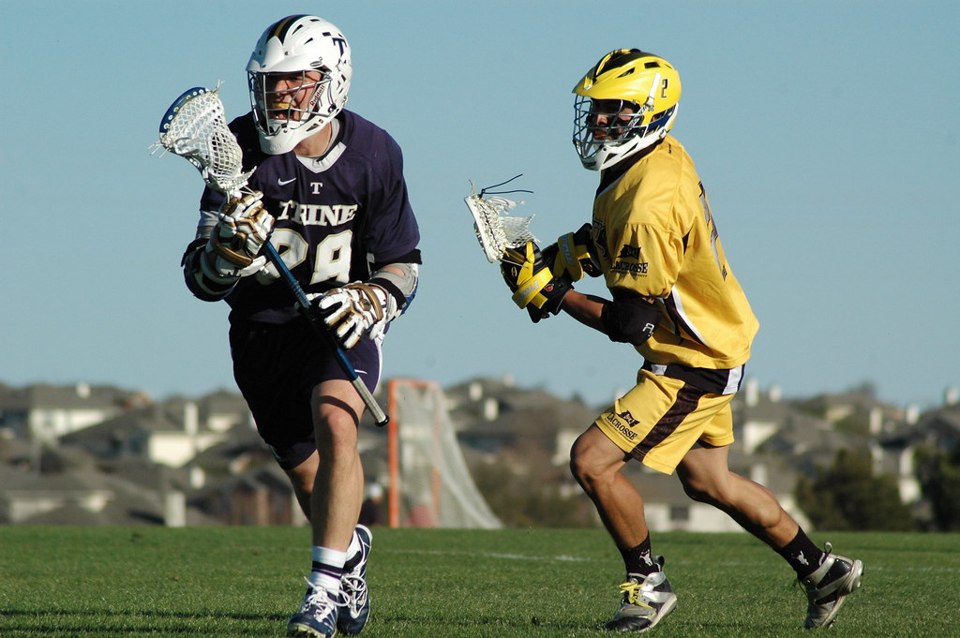
Basic Principals for Short Stick Midfielder’s
Understand your leverage on the offensive dodger, and where we want to push him.
Be physical with your man on-ball, and punch him on any dodge. We never allow an easy run. If he becomes a threat, engage him physically.
Wrestlers Mentality – Match Athleticism until they get into your stance! Too Much – You run past the dodger – Too Little – They Run past you!
If he dodges down the side get ready to get off and rotate back to original position once wing defender takes over we make a “Pass Call”
Always see the wheel and understand someone might replace where you just left from.
If offensive midfielder dodges across your face to the middle of the field chase from behind, and go for the back check. If he dodges inside he will run into our double. Don’t let him off the hook!
If you are off ball you share the crease and will always be in a help position. If you are the backside man you split two and react to any ball thrown over the top.
Know difference between 1 high, 2 high, and 3 high up top.

Slide 8
BINGO & CREASE
The main objective is to take away all inside looks on the crease and to spoke in and out.
Give support where needed either up top or behind. The Bingo and Crease are partners with each other, so communication is key.
Always be ready to double when the ball comes to the middle of the field. Be aggressive, and take the ball away.
Always front your man inside. When Crease is at X, Bingo covers crease area. When Bingo is up top, backer covers crease area. Work together on a string
It is important to play the ball hard when you are up top in the middle. If you are the low backer only play hard if the attacker starts to press GLE. (Soft Zone/Dead Zone Concepts important) Play the 5 yard rule behind the cage.
Always get on their hands, and make them go East - West.

Slide 9
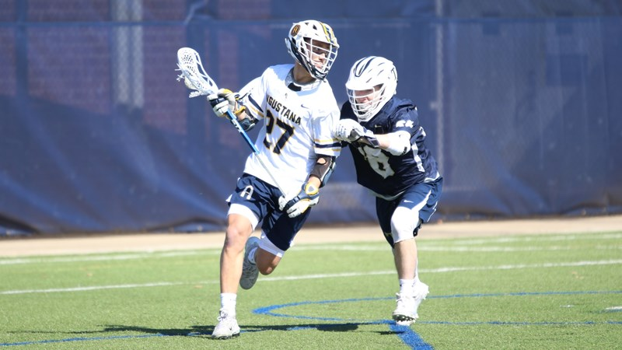
Low Wing Defenders
Always be in a help position vs. dodges down the side - Show but don’t go!
Try and hold off passing until the midfielder is really beat. – WE SWITCH – NOT SLIDE
If you do have to slide up field, do it with your stick up field in chest of dodging midfielder.
If your man dodges from the wing, play topside. Make them roll inside where you have backer help
Stay on the hands of a feeder and don’t allow him to step around you for a shot.
Understand our 1 behind or 2 behind concepts.
We typically stay on ball when they carry from the wing to x, with other two defenders rotating to replace. Wing becomes Crease
Sticks are always up and in passing lanes while playing off ball
Once you are “Off-Ball” make sure you have a big presence inside helping crease, while keeping leverage on what is going on in your area (Head on a swivel!)

Slide 10
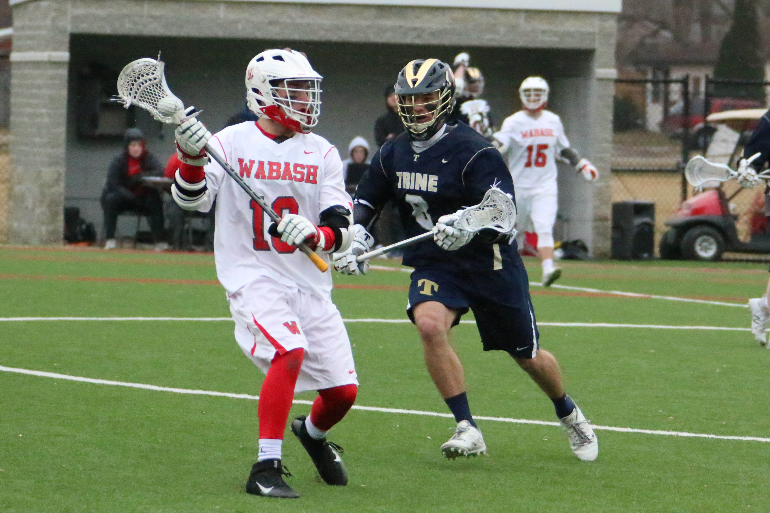
Goalie Play
How you project yourself to our team is extremely important! Be loud, and confident in what you are doing.
Always be ready to make the next save, and play with enthusiasm.
Good or bad - control your emotions!
See the ball, Relax in your stance, and be aggressive.
Anticipate where the shots and passes will come from and lock in. Vocalize ball position and urgency to the defense.
We are going to give up 13 yard shots. (Eat them Up). Be patient and see the ball so you can explode.
If you make saves on 2 out of every 3 shots we will be in good shape
Make teams try and be perfect when they shoot.
Control the ball after the save and get it back up the field in transition

Slide 11
Ride
Cuse
A1 - Nearest to ball; scrape across field. Cut off ball carrier/look to run carrier into M4. D7 will help with M4 man
A2 – pick up any cutters in mid of field
A3 – you have backside snap lane responsibilities
M4 – look to double ball carrier, if possible. Do not leave your man to go down field to double. Allow ball carrier to come to you
M5– start edging off side to get into the hole if need be
M6 – get into the hole. Help the defense on the backside when D7 picks up M4
D7 – pick up M4 man on double
D8 – pick up D7 man when he slides up field
D9 – pick up D8 man when he bumps to D7 man
21
A1 & A2 – Runners; objective is to force cross field passes. When X1
has the ball, A2 NEEDS to get to the goalie A3 – floater; picks up other extra man M4,5,6 – Match feet with opposite mid field
* M6 – HAS CRASH RESPONSIBILITY IF RIDE BREAKS DOWN!
D7,8 - Can cheat up field to help M5 when A3 man stretches over mid line
D9 – help from backside of ride to center of the field to help D8
* HAS TO COMMUNICATE! YOU SEE THE ENTIRE FIELD!
*FRONT SIDE PLAYERS, MATCH UP! BACKSIDE PLAYERS, HELP TO
CENTER OF THE FIELD!*
X1
X2
X2
X1 A1
G
G
A2
X3
A1
A2
x
X4
A3
X5
X4 M4
X6 M6
A3
X3
X6
M4
M5
M6
M5 X5
D7
D8 X8 G10
D9
D8 G10
D9
X8
D7
X7
X9
X9
X7

Slide 12
Ride
WHO DEY – 10 Man
A1 - Nearest to ball; Pressure Ball Carrier. Cut off ball carrier/look to run carrier into Double. D8 will help with M4 man
A2 – Lock Off Goalie – If Ball Goes Above – You can Jump Carrier
A3 – you have backside Lock – Can Shift towards middle of field
M4 –Do not leave your man to go down field to double. Allow ball carrier to come to you
M5– Lock off nearest man
M6 – Lock off Man Coming from Sub Box. Help the defense on the backside
D7 – pick up X7 and lock off
D8 – You are the Rover – You Hunt the Ball!
D9 – pick up X9
G10 – Pick Up Nearest Man!
X1A1
GA2
X2A3
X3M4
x
X4
X5
X6D8
M5
M6
X8 G10
D9
D7
X7
X9

Slide 13
Clear
Hot Dog– Clear
A1, A2, A3 – Work to Give Space And provide Outlets in Alleys – Work Slow or Fast Break
M1 – Break Up To Frisco
A2 – Linger in the Middle and Work to Frisco Wing Line
M3 –Coming On for D3 – Break to Middle of Field
M4– Coming on for LSM – Linger Box side onside!
LSM – Break Up the Field for Quick Hit – Then Work Off for M4
D1 – Get In The Alleys and Create Space
D2 – Get in the Alleys and Create Space
D3 – Break to Box and Sub off for M3
G – Direct Traffic and Find Open Man – DON’T SHRINK THE FIELD
A1
A3
GA2
x
M1
M4
LSM4
M3
D3
M2
D1
G
D2

Slide 14
Clear
Diamond– Clear
A1, A2, A3 – Work to Give Space And provide Outlets in Alleys – Work Slow or Fast Break
M1 – Shark to Ball
M2 – Break Up Field Behind Shark
M3 –Coming On for D3 – Break to Middle of Field
M4– Coming on for LSM – Linger Box side onside!
LSM – Break Up the Field for Quick Hit – Then Work Off for M4
D1 – Get In The Alleys and Create Space
D2 – Get in the Alleys and Create Space
D3 – Break to Box and Sub off for M3
G – Direct Traffic and Find Open Man – DON’T SHRINK THE FIELD
A1
A3
GA2
M4
LSM4
M3
D3
M1
M2
D1
G
D2

Slide 15
Clear
ABCD– Clear
A1, A2, A3 – Work to Give Space And provide Outlets in Alleys – Work Slow or Fast Break
M1 – Break Out Get to Midline
M2 – Break Up Field Behind Shark
M3 –Coming On for D3 – Break to Middle of Field
M4– Coming on for LSM – Linger Box side onside!
LSM – Break Up the Field for Quick Hit – Then Work Off for M4
D1 – Get In The Alleys and Create Space
D2 – Get to top of Box in Middle of Field
D3 – Break to Box and Sub off for M3
G – Direct Traffic and Find Open Man – DON’T SHRINK THE FIELD
A1
A3
GA2
M4
LSM4
M1
M3
D3
M2
D2
D1
G

Slide 16
Call Sheet
Defense
Eagle – Early Call – Slide Early |  |  |  |  |  |  | Ride/Clear
BLACK – Lock Off everyone – Play Ball Hard – Go for Takeaway |  |  |  |  |  |  | Diamond – 2 middies to the top of the box – 2 Close D in the corners; 3rd at
FIRE– Slide Call |  |  |  |  |  |  | Hot Dog - Middies Out Wide - LSM Up The Middle of the Field - Boston Pole Off
RICO – Person Slid to. Slide guy releases him from double and recovers to the crease |  |  |  |  |  |  | Cuse – Ride – 3 Attack Across Near Midline – 10 Man Ride
Reduce – Opposite Ball – Sluff in and Help on Crease |  |  |  |  |  |  | Panther – Man Down Clear – Panther is always Shorty –
Cobra – Ball Below GLE – Slide Comes Cross Crease |  |  |  |  |  |  | Designated LSM comes to box for Middie. Attack are at top of Far Restraining box.
Regular – Backer Zone Defense - Hybrid Defense |  |  |  |  |  |  | Basic Calls -
Pillars – 4 Corners in the Zone – Can be a shorty or Pole |  |  |  |  |  |  | Boston – Box Side
Bingo – Slide Man/Help Man in the Zone – Always in the middle |  |  |  |  |  |  | FRISCO – Opposite Box Side
Regular – Two Poles at Low Pillars, Two Shortys High Pillars LSM is Backer with Pole as Crease |  |  |  |  |  |  | Reduce – Sluff in; Help On Crease
Fourman – Four Poles as Pillars, Two Shortys are in Middle playing crease and Backer |  |  |  |  |  |  | Spike – Push Ball Down wing Through X
NUMBERS - Man Defense |  |  |  |  |  |  | Shark – Man Hunting Down to Ball
50 - Sit Back at the Hot Zone and Pack It In |  |  |  |  |  |  | Fly – Flying above Shark on Ball Side
100 - Pressure Ball Adjacents are in Hlaf Position |  |  |  |  |  |  | Stretch – Ball Carrier coming at you? Stretch away to make more space
200 - Pressure Ball and Adjacents |  |  |  |  |  |  | Wholesale – Everyone
300 - True Backer Zone - Always Pass Off and Pack It In |  |  |  |  |  |  | Zombie - MAN ON! Tuck your Stick and Run to Space
Lion - Double Lock on Shorties |  |  |  |  |  |  | ICE CREAM – Slow Down Call – We Want to Substitute
Animals - Zone Defense |  |  |  |  |  |  | Red – DO NOT GO TO THE CAGE
Smash - Double Ball side Pass with Poles |  |  |  |  |  |  | Green – Play Normal
Indiana – Two Bottom Pillars are Shortys – Top Pillars are Poles – Crease and Backer are Poles |  |  |  |  |  |  | Buzz/Boston – Substitution Through the Box
Smash - Double Defense - Deny Topside - Double Ball - Push Below GLE - Double Comes from Back |  |  |  |  |  |  | DEEP– Subbing through Midline – Pulling Pole off the field
Dagger - Double Call
Fish/Fish on the Line - Match Up - Go Take The Ball |  |  |  |  |  |  | Man Down
 |  |  |  |  |  |  | 40 - 4 Man With Lock on Crease
 |  |  |  |  |  |  | 50 - 5 Man Rotation
 |  |  |  |  |  |  | Black Plus Number - Press out on that Pass

