Slide 1


the psychology of
Building & Being
Great Teammates
ADAM STEWART
Founder: the GR8 TM8 project
adam@gr8tm8.com
+

Slide 2




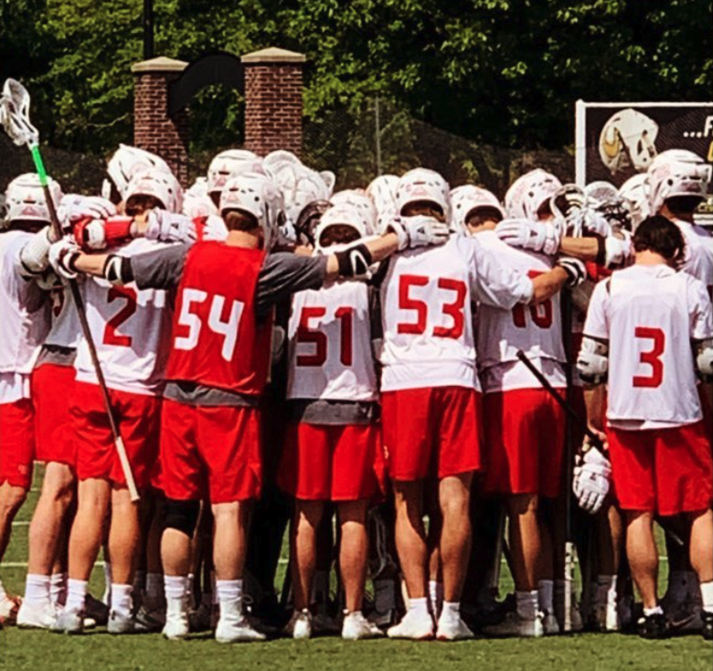


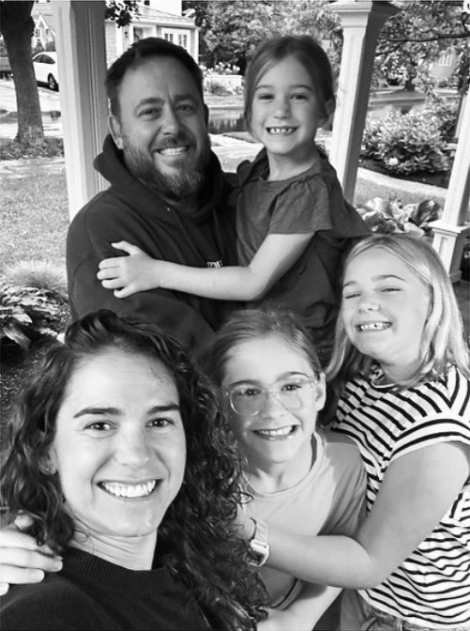
Father.
Husband.
Son.
Brother.
Friend.
Coach.
Business Owner.
Community Member.
Purpose Driven Servant Leader.

Slide 3
Why Does That
Matter to You and to Us?

Slide 4
Father/Mother.
Husband/Wife.
Son/Daughter.
Brother/Sister.
Friend.
Student.
Athlete.
Community Member.
Leader.
We are all…

Slide 5
Why does this matter in the sport of lacrosse?

Slide 6
VULNERABILITY & TRUST

Slide 7
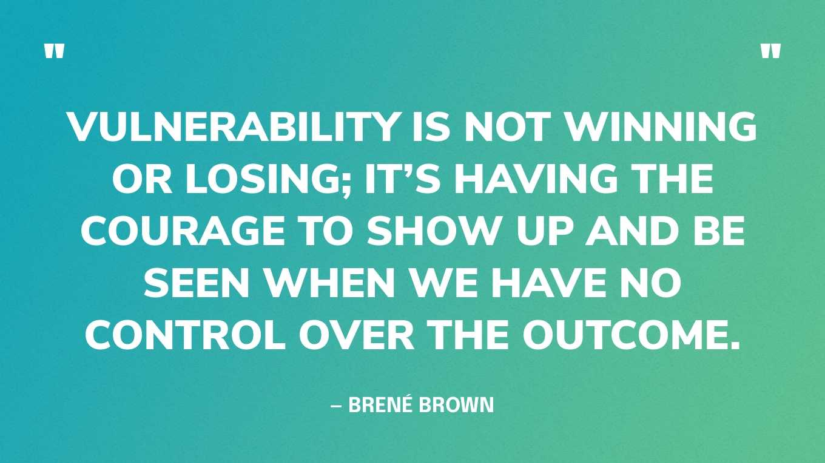


Slide 8
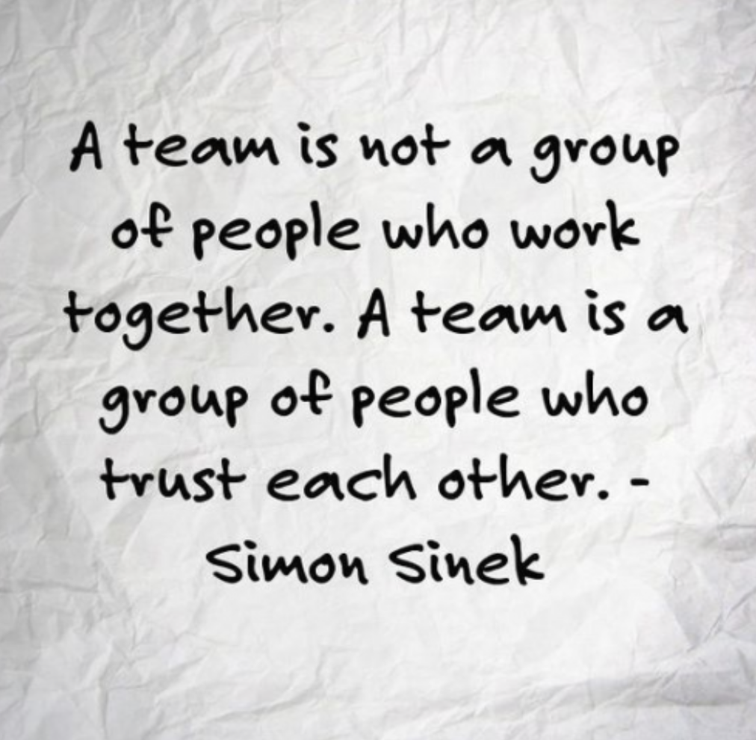

Slide 9
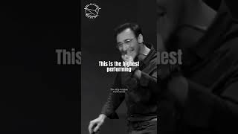

Slide 10
TRUST?
who, when, why…

Slide 11


Slide 12
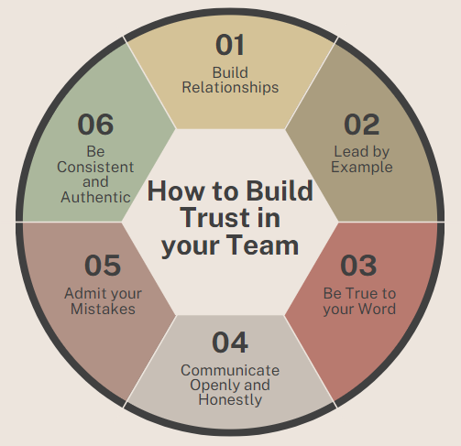

Slide 13

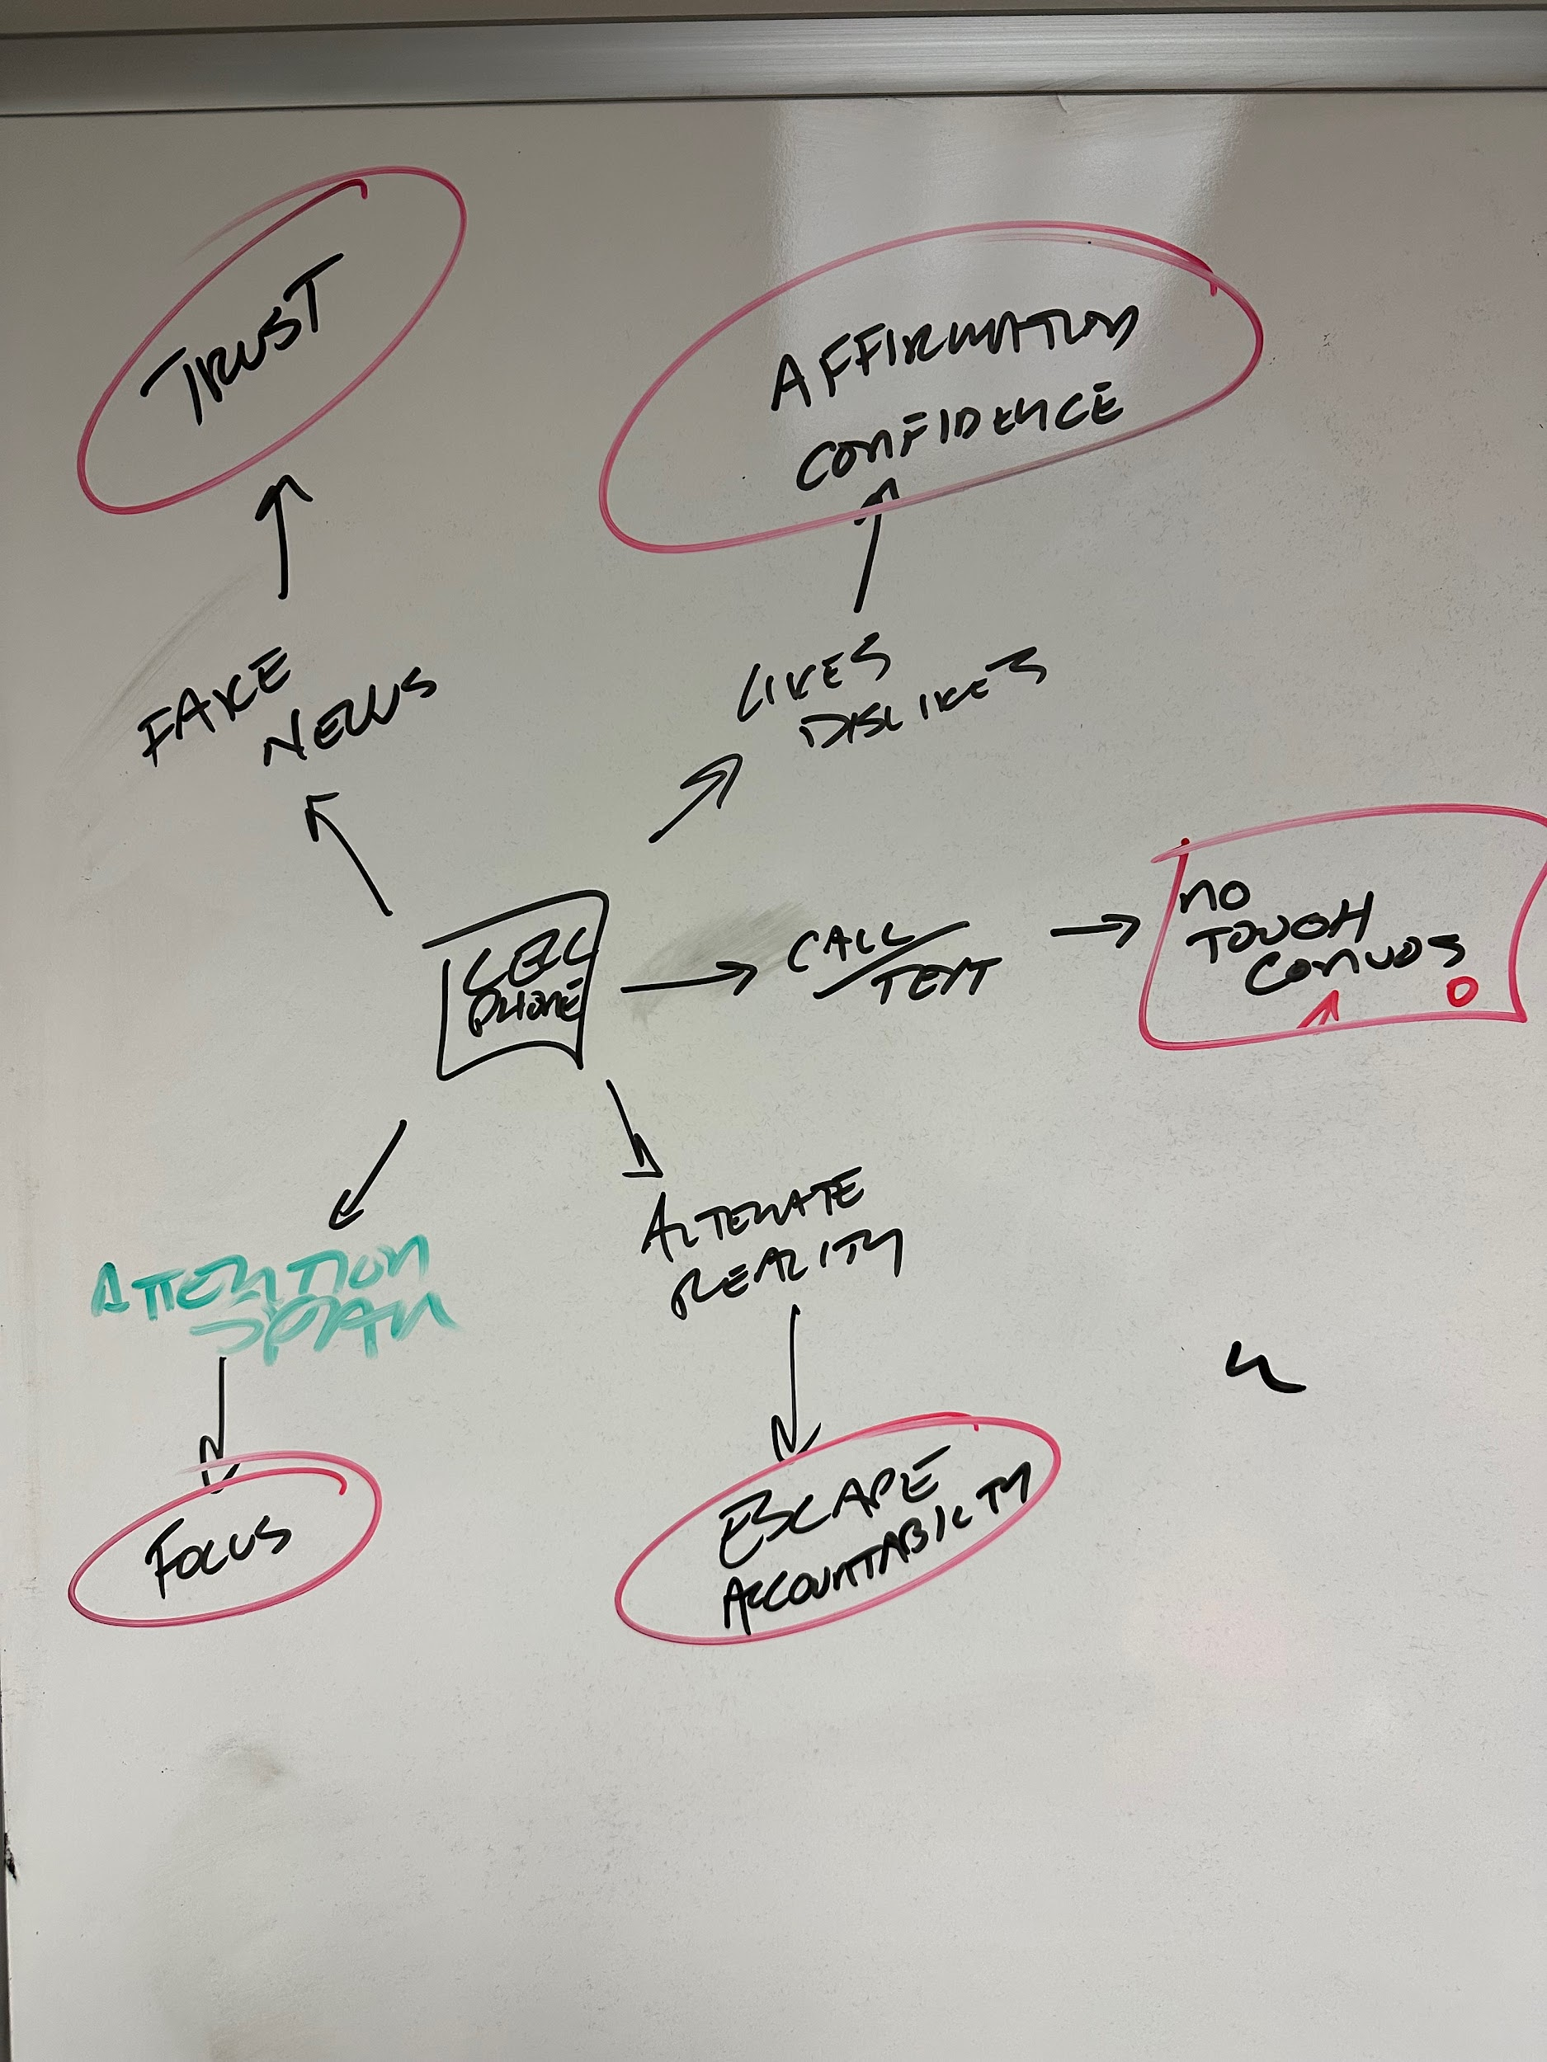

Trust & Connection in the modern world…
IDEA CURRENTLY

Slide 14


Slide 15
How Do We Create an Environment for
Failure, Trust & Sustainable Success?

Slide 16
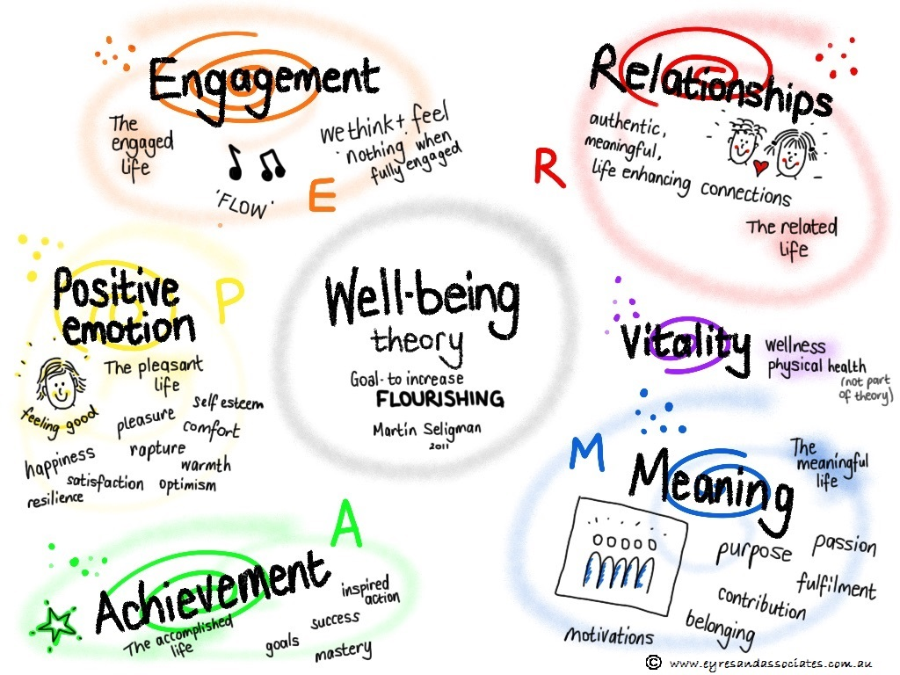

Slide 17

HOW DO WE MANAGE IT?

Slide 18
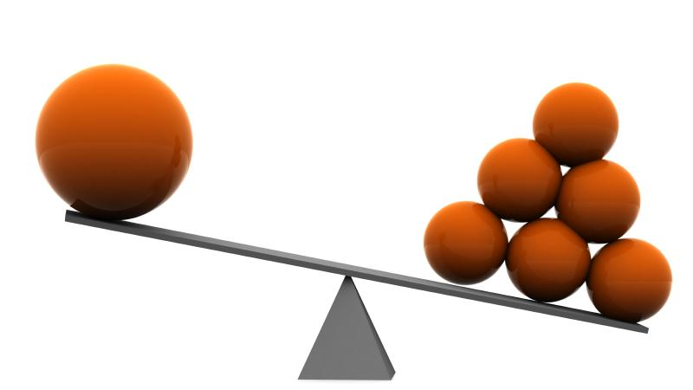
THERE IS AN “I” IN TEAM

Slide 19
60,000
thoughts per day
41.6
thoughts per minute
XX%
thoughts are negative

Slide 20
up to 75%

Slide 21
20min
complaining per day
140min
complaining per week
9.3
hours per month

Slide 22
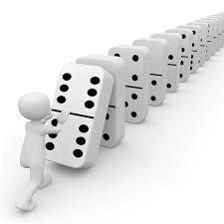
60,000+ POTENTIAL DOMINOES

Slide 23

“Talk to yourself like you would talk to someone that you love.”
-Brene Brown

Slide 24

TO SERVE OTHERS…
ME.
THEN YOU.

Slide 25
ME.
YOU.
TEAM.

Slide 26

DELIBERATE LANGUAGE.
SHARED
VISION.
DEEP CONNECTION.

Slide 27
The Culture Code
“One misconception about highly successful cultures is that they are happy, lighthearted places. That is mostly not the case.
They are energized and engaged.
At their core their members are oriented around solving hard problems together.
This task involves many moments of high-candor feedback, uncomfortable truth-telling, when they confront the gap between where the group is, and where it ought to be or wants to be.”
Daniel Coyle

Slide 28
Vestibulum congue
1:1
Family & Student Sessions
Coaches Sessions
100%
UNIQUE
TO
YOU
Vestibulum congue
Vestibulum congue
Large Group Sessions
Full Teams & Departments
Small Group Sessions
Teams & Coaching Staffs
Leadership Groups

Slide 29
thank you.
ADAM STEWART
Founder: the GR8 TM8 project
adam@gr8tm8.com
+

