Slide 1
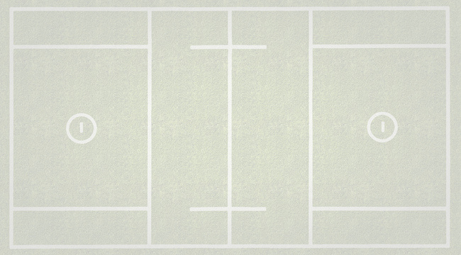
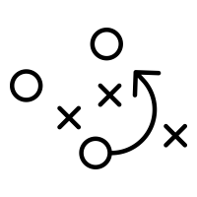
TRUE
LACROSSE
Defensive Concepts and Techniques that needs to be in every coaches training manual.

Slide 2
Objectives – "Where do I start?"
Our Role as Coaches: Build a Defensive Identity
  Build Confident, Communicative, and Tough Defenders
  Great Footwork is our number 1 priority
  We don’t get beat 1 on 1
  When the ball hits the ground, it is ours
  Physicality ( GDTBAP ).
  Skill ( Ground Ball Technique )
Outline Core Values & Key Principles
Buzzwords & Communication Standards
  Introduce & Reinforce for clarity
  Consistent terms across age groups to build a shared language
Teaching Priorities by Age
4

Slide 3
Defense is an Identity – Where to Focus
Your Identity might look different at 10U vs 16U, A, AA, AAA
Ask: "What do we want our opponents to feel when they face us?"
Key Identity Elements:
  Tough – Loud – Disruptive
  Help Mentality
  Paint Protection / Inside Out
  Fast, Physical, Skilled
  Athletes=Press out
  Controlled Aggression
Old School vs New School...??
  Don’t get beat
  Don’t slide
  Don’t foul
Encourage Age-Appropriate Identities:
  Youth
    Focus on fun, footwork, fundamentals
    Ground Ball Technique
    Off ball play
  Middle School
    Begin teaching systems and off ball technique. ( 2 Slide, 3 Slide, Body Positing off Ball, Stick positioning )
  High School
    Install structure, advanced terminology, and multiple schemes
    Be tougher
    Accountability is important
    No palms up when a mistake happens
4

Slide 4
Teaching Priorities by Age
8U – 10U
  Footwork & Positioning
    Stance
      Chest Up, Butt Down, Stick Out
    Angles
      Force them one way
    "Turn & Run"
      Maintain distance/contact
      Slide Step vs Back pedal
12U-14U
  Communication & Approaches
    Always be sideways offball
    Stick Parrell to Ground
    Intro "The Paint"
High School
  Team Defense & Slide Schemes
    2-Man Game
    Slide Speeds
    Recovery & Rotations
What We Coach!?
How to win matchup – Feet & Fists
Keep the ball out of the middle – Approaches
Initiate contact – Encouragement
Communicate – Loud. Early. Often.
Play together – Jump Heavy/Slide Recover
4

Slide 5
Example: Identity & Core Values of Your Defense
Rigid
  On ball – "give us 3 good seconds"
  Square Up & Make Contact
    Retreat Steps
Engaged
  Off ball – Read the life of the dodge
  Level / Stick Inside – 1 pass away
  Melt In – 2 pass away
  "Ice & Melt"
Deliberate
  Communication aka with everything!
  Support - "Jump Heavy"
  Slide Package & Recovery Speed
  Dice – Stay on the double
Violent
  Off the turf and up the field.
  Good defense creates offense!
4

Slide 6
Key Defensive Principles
L.E.O
  Loud, Early, Often
  Talk solves problem
  Comms are 2-way street, need talk but must listen
PEP's
  Possession Ending Plays
  Smash – Back of helmet
  Steals – endline run outs
  Scarecrow & Scrapes – stick in lanes
Approaches
  Approach well, defend well
  Crowd – Strike Zone – AWP/LWC
  Keep him going one way
Footwork First
  Coach feet and up!!
  You can't play good defense if you can't move your feet
  Good defense with a bad matchup up is better than bad defense with a good matchup
  vs
  You clean up off ball defense with better on ball defense.
4

Slide 7
Teaching: Approaches, On-Ball, Off-Ball
Off Ball
  Support & Anticipate
Melt into the paint. Paint = The priority!
Know your slide:
  Bingo – 1st slide
  Fill / Plug – 2nd slide / shared support
  Plus – Drift & deter ball movement
“Flat Triangle” Vision – See ball + man
Always Protect the Middle!
Be Sideways
Great Body Posture
It Starts With Your Feet!!
  “Approach well = Defend well”
Teach:
  Square Approach: Chest to chest, stick parallel.
  Retreat: Slide Step Back Pedal
  Crash Approach: Favor off-hand. Deter strength.
  Feet & Fists: Move feet, make contact, stay low.
  Strike Zone: Ribs to hips under the arms.
On Ball
  Win the 1v1
Force Dodger One Way ( Furthest away from the Cage )
Stay Engaged – Be Rigid
“Give us 3-5 seconds of ICE”
No Footwork, No Defense – Teach body mechanics first
Skewer / Stab the Heart tech – closing the gap/trailing or late arrivals
4

Slide 8
Teaching: Hold Spots, PEP, 2-Man
Hold Spots = Hold Structure
Hold when dodge initiates
Stay disciplined
  Don’t over-rotate or over-help
Structure > Matchups
Early Decisions = Early Action = Full Speed Mistakes (That’s OK!)
PEP – Possession Ending Plays
GBs – Win the ground war
Smash – Create doubles on GLE/dodges
Kill – Swarm on loose balls, end possession
Clear First Time – Pride in stickwork and execution
Challenge: Grade players weekly on PEP contributions
2-Man Game & Picks
Communicate Picks
  “Pick Left, Pick Right”
Stay sticky until told otherwise
Default: “Stay,” but teach “Switch” and “Dice”
Be ready to Space, Chip, or Jump Switch
4

Slide 9
How to evaluate a defenseman
  1. Footwork ( Can they defend one on one ).
  2. Groundballs ( Can they get the ball off the ground and run with it up the field.
  3. IQ/Off Ball Play ( Do they understand team defense, communicate, and have great body posture.
5

Slide 10
Final Thoughts: Practice Planning & Recap
EVERY PRACTICE SHOULD INCLUDE:
Footwork + Approach Circuit
Slide & Recovery Drills (vs air)
1v1's + Paint Protection
Communication Emphasis / Reps
Live Decision-Making Drills
Groundball Technique Drills
Recap / Overview
Build YOUR Defensive Identity
Demand Structure, Comms, Effort
Coach to Your Comfort
  Always Teach: Movement, Contact, Communication
The Paint is our HOME
  Defend this together!
6

